Slide 1
Diagnostics of Wheat Samples
Jan Byrne, MSU Diagnostic Services

Slide 2
2015 -16
33 samples
Submitted by extension educators, agribusiness, and growers
Samples processed for signs of disease and abiotic problems
Nutrient testing where appropriate

Slide 3
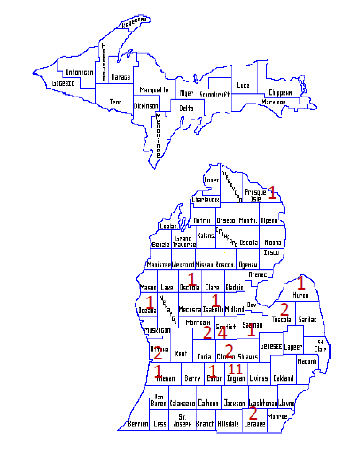
Samples received from 15 counties

Slide 4
Findings in 2016

Slide 5
Root rots
Take-all
One sample
Pythium sp.
One sample

Slide 6
Foliar Pathogens
Rust
Stripe
Leaf
Powdery mildew
Bacterial mosaic
Wheat streak mosaic

Slide 7
Wheat Streak Mosaic

Slide 8
Wheat Streak Mosaic

Slide 9
Stem Rot Pathogens
Eye spot
Take all

Slide 11
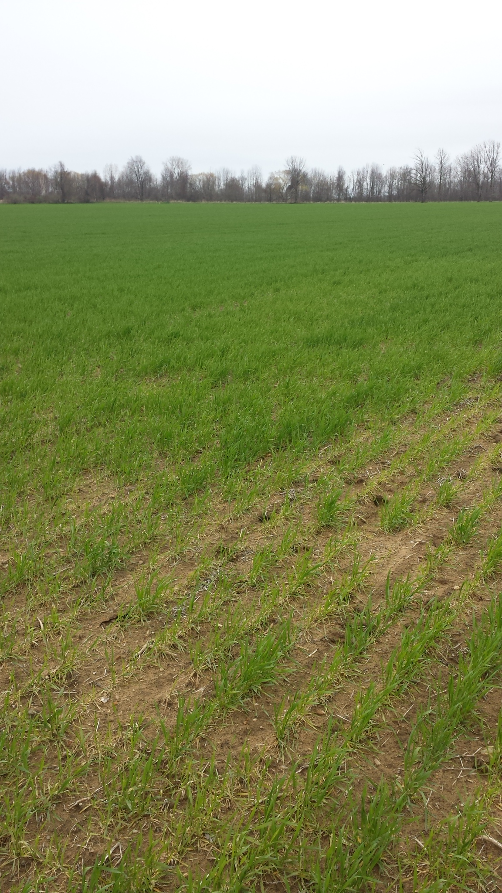
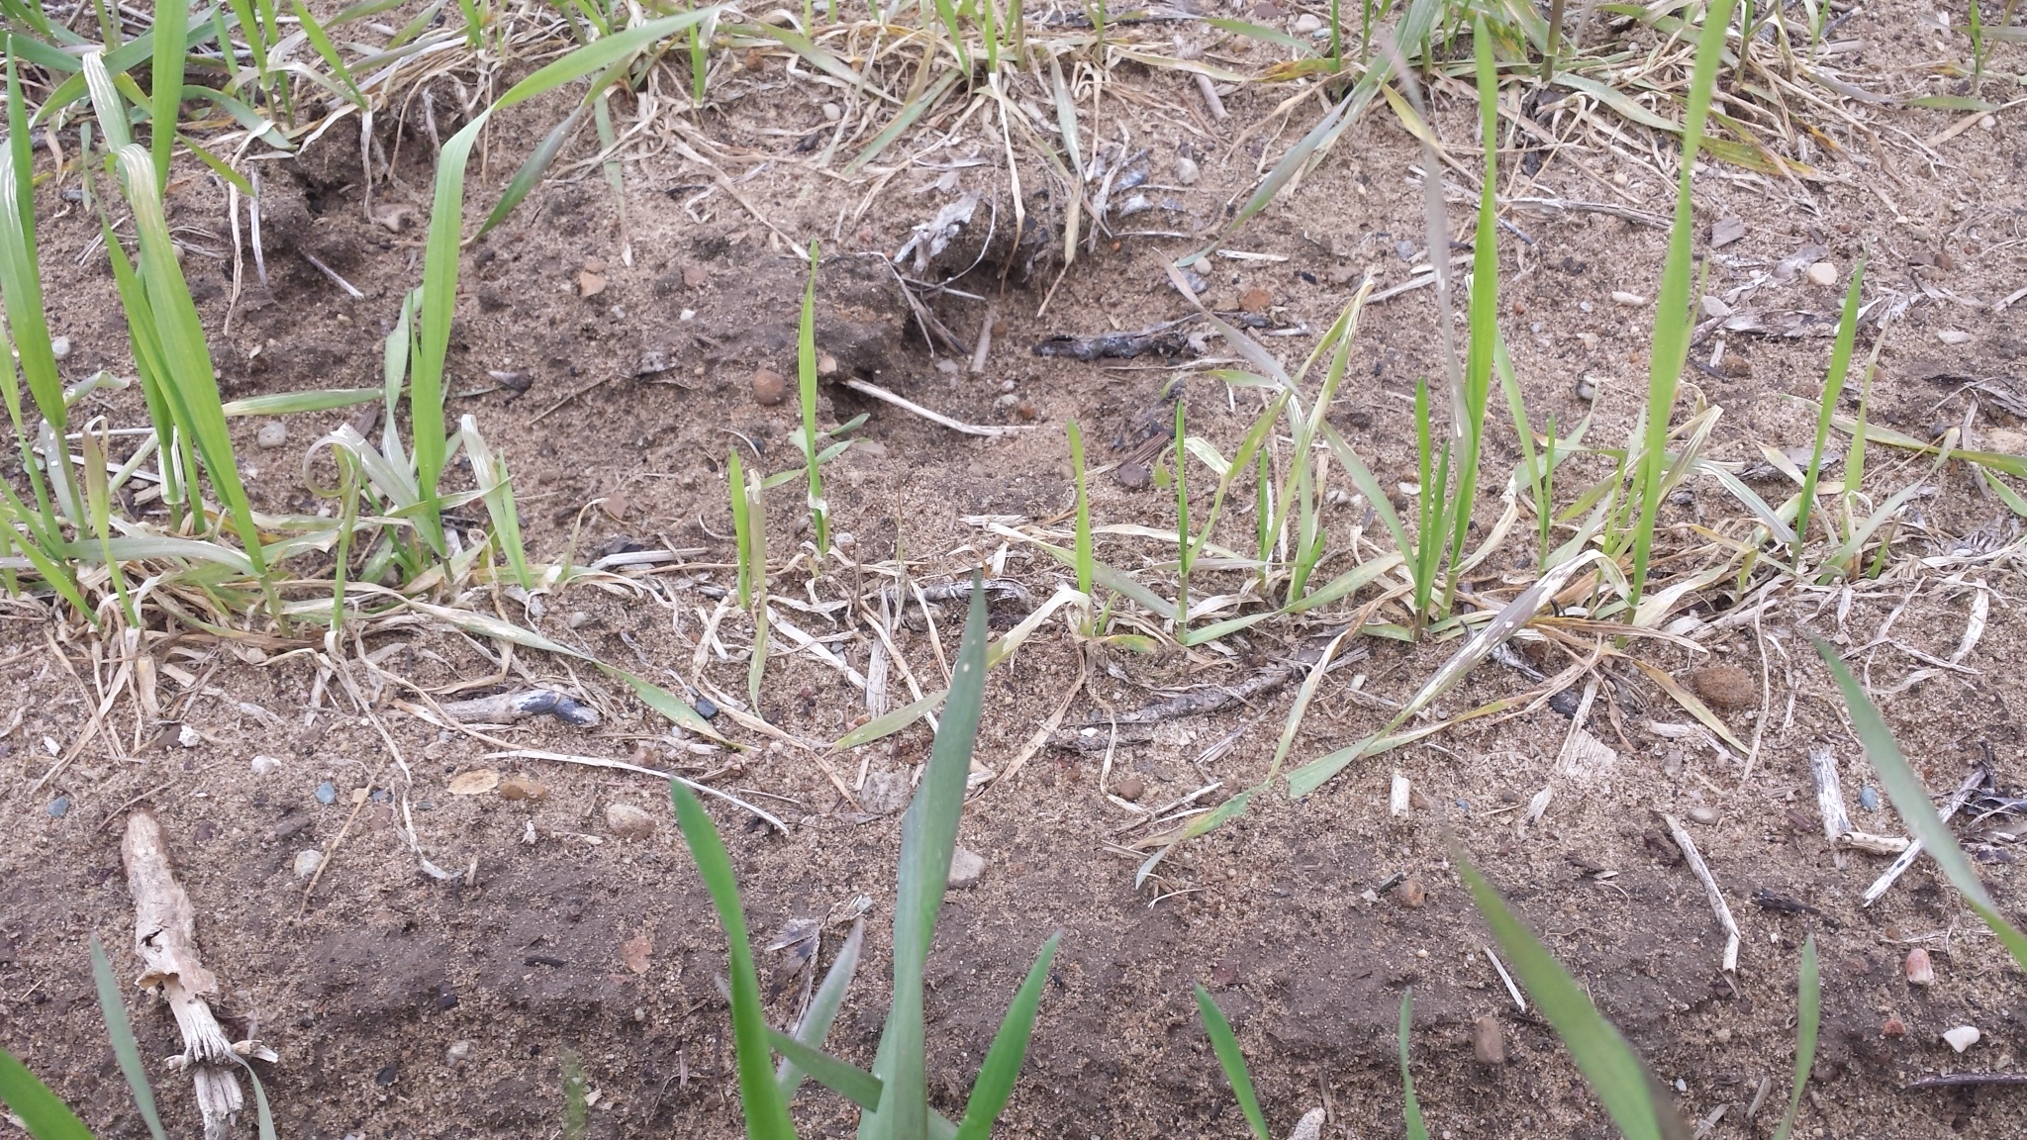

Slide 12
Nutrient Related Issues
13 samples
Low in
Sulfur
Zinc
Boron
Phosphorus
Soil pH issues

Slide 13
Diagnostic Support
Field visits by Dennis Pennington
In response to sample submitted to the MSU lab
Or
Lab work to support field visits

