Slide 1
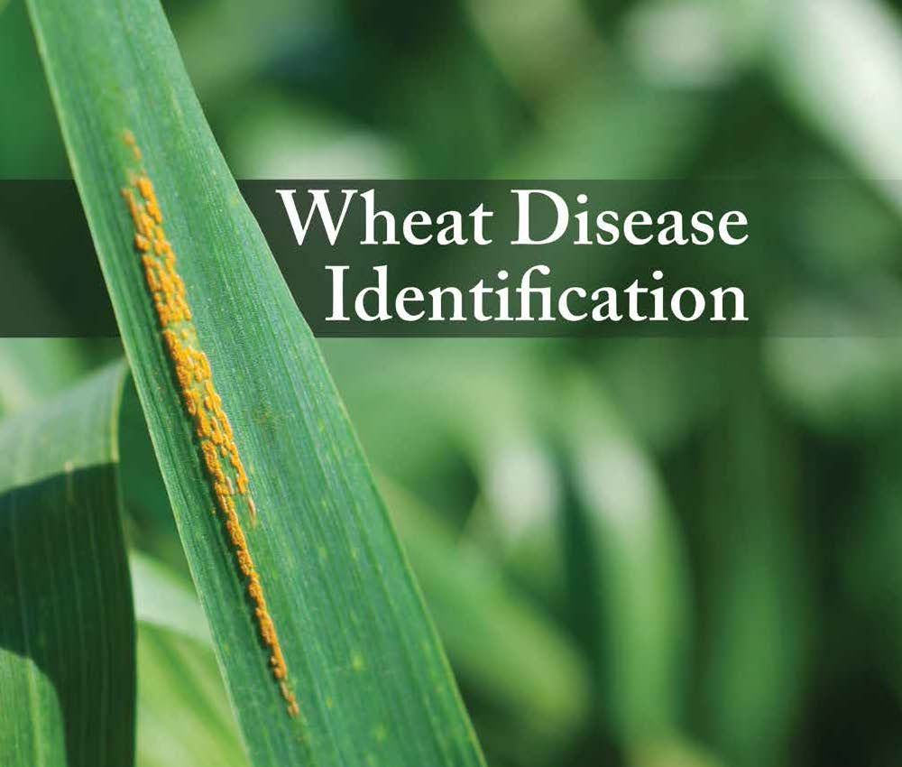

Intro to Disease ID booklet
Martin Chilvers
Martin Nagelkirk
Annual Wheat Grower Meeting
March 14, 2017
Frankenmuth, MI
Created by multi-sate Extension and research committee
E. DeWolf et al, Kansas State U.

Slide 2
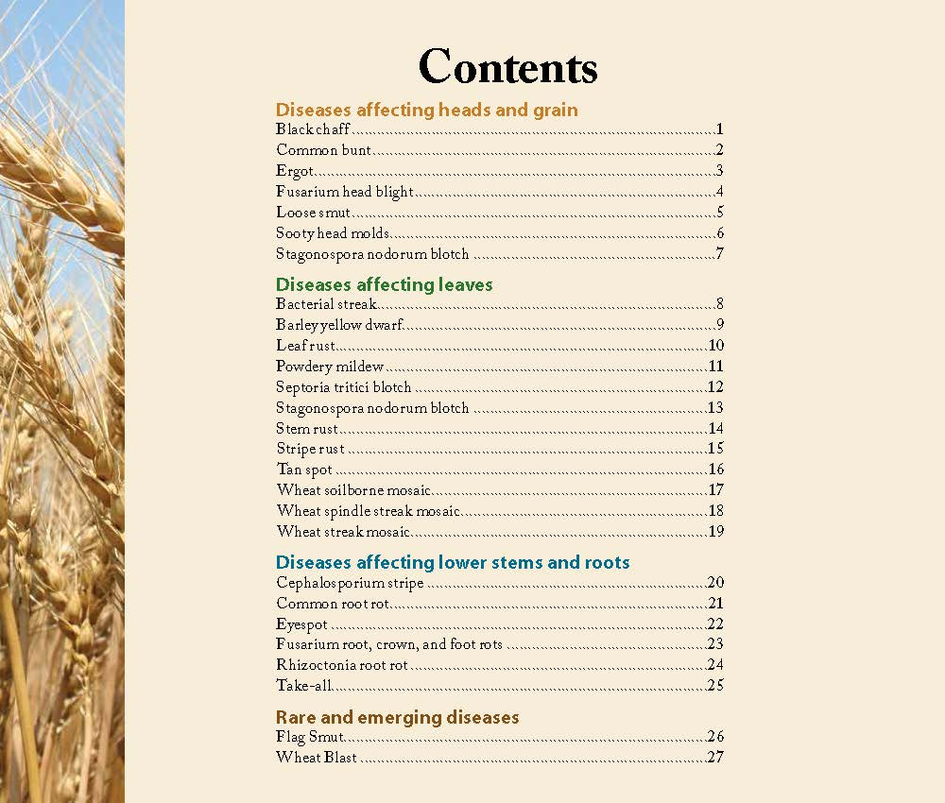
Diseases affecting :
heads and grain
leaves (foliar)
lower stems and roots
Other than a few viral and bacterial pathogens, greatest losses are due to fungal pathogens

Slide 3
The frequent foliar fungal four – plus 1 (?)
- there are a few leaf diseases that show-up in
MI wheat each season…….

Slide 4
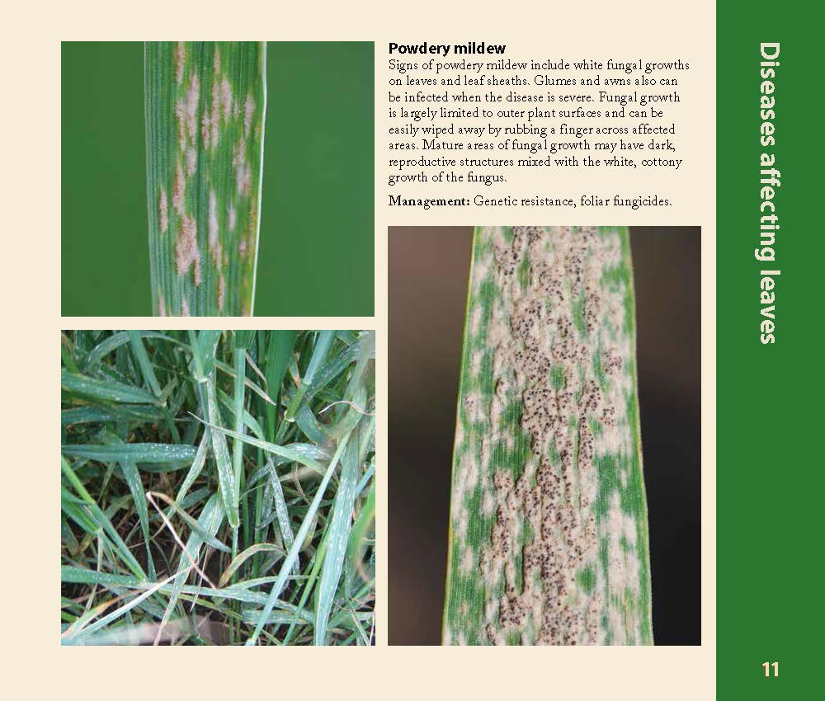
No. 1 - Powdery mildew (pg. 11)
early season fungal disease
favored by cool temps
60 – 70 F

Slide 5
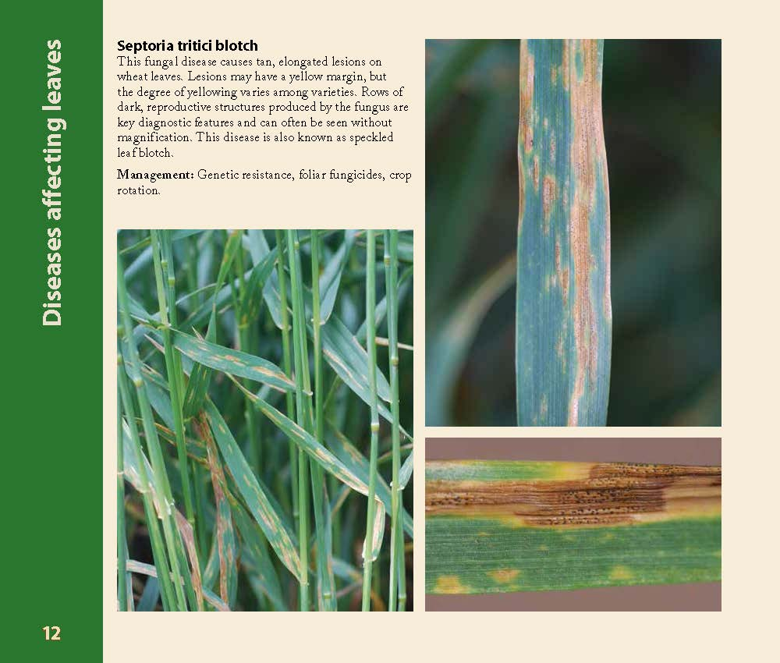
No. 2 - Septoria leaf spot/blotch (pg. 12)
  Early foliar disease
  Favored by cool temps.
  Present in fields now
12

Slide 6
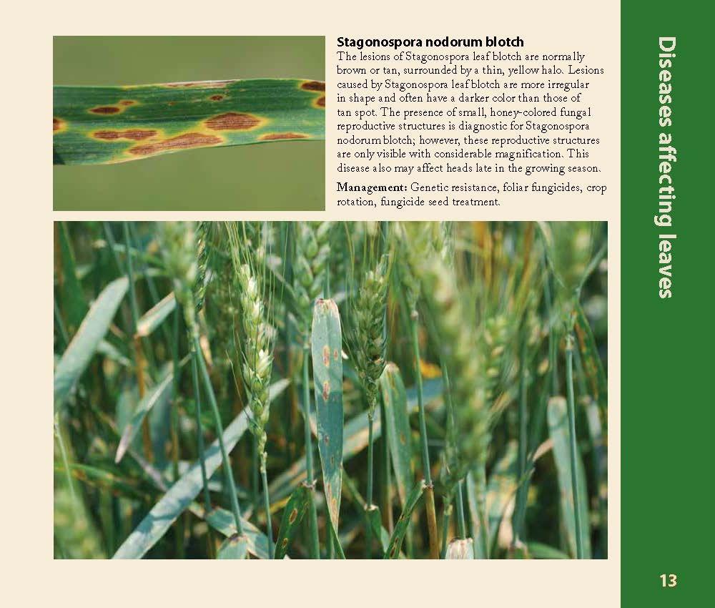
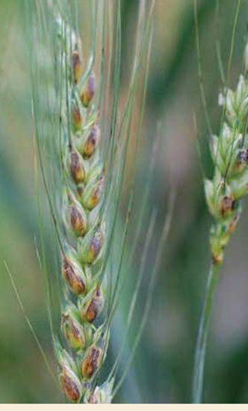
No. 3 - Stagonospora leaf blotch (pg. 13 & 7)
Infects both leaves and head
Looks very similar to Septoria leaf spot
Favored by relatively warm temps (optimum 68 – 75 F)
Head infection (glume blotch) pg. 7

Slide 7
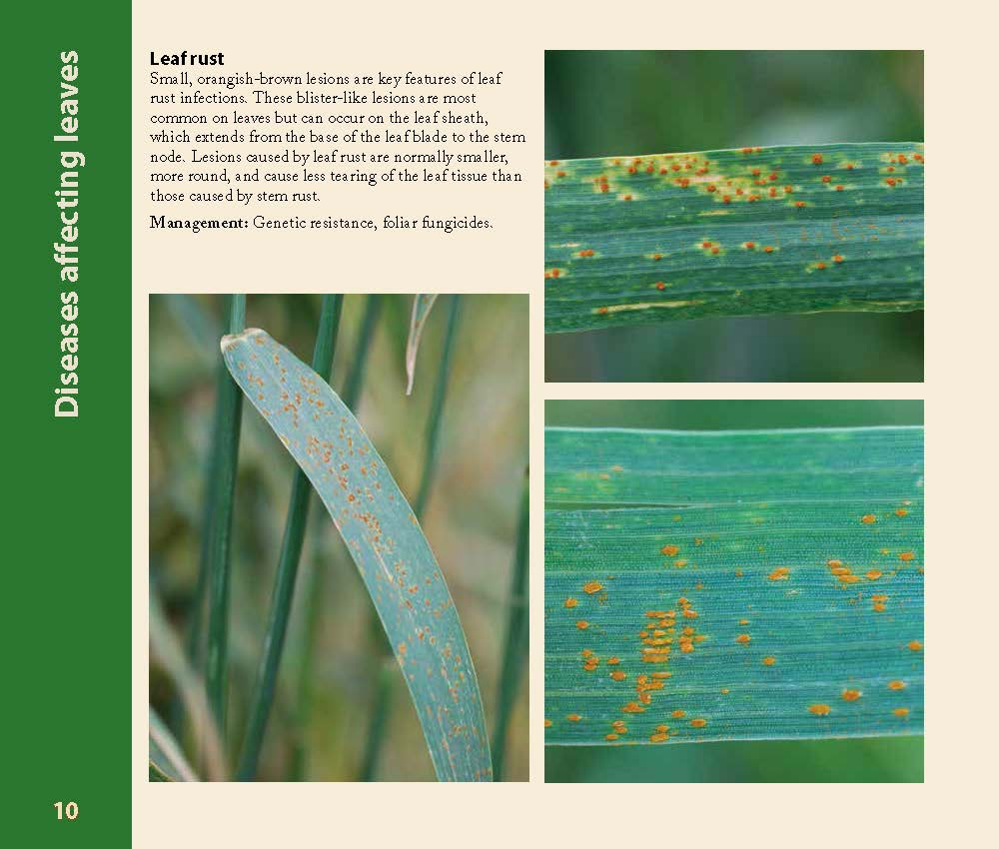
No. 4 - Leaf rust (pg. 10)
Spores from states to the south and west
Favored by warm temps (64 to 78F)
Pg 10

Slide 8
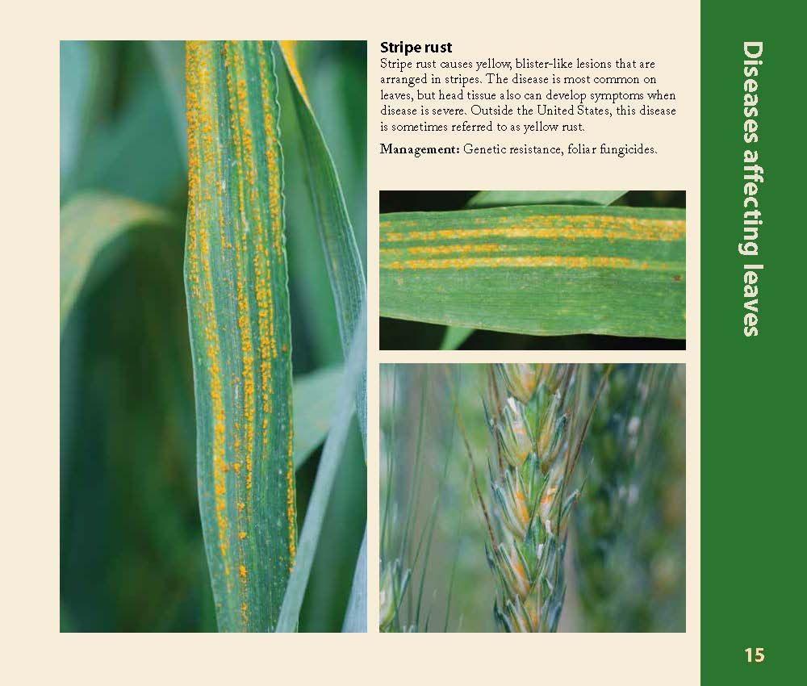
Stripe rust (pg. 15)
Favored by cool temps
45 to 65 F

Slide 9
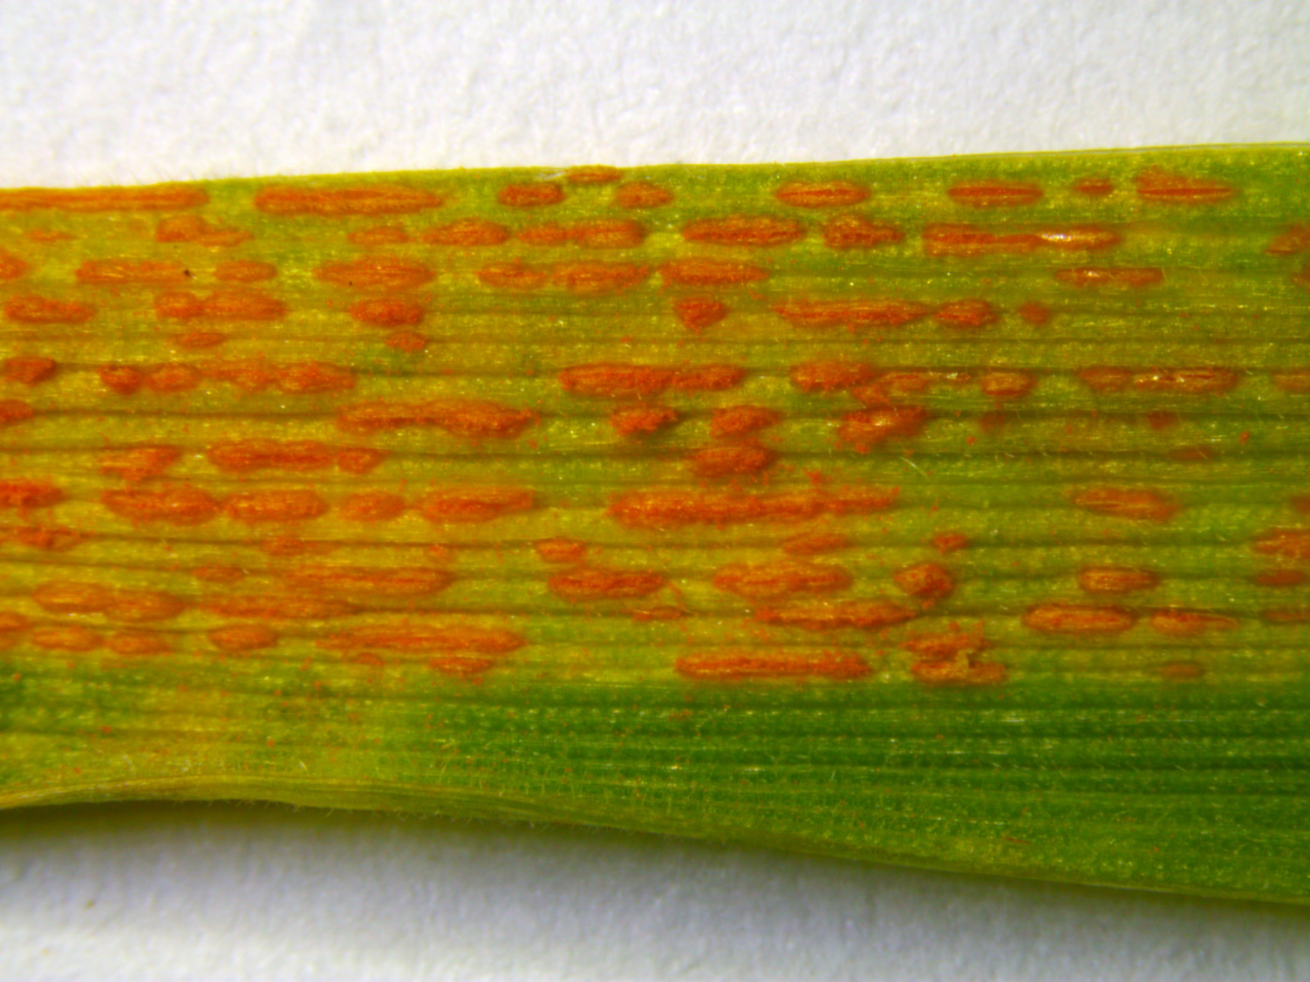
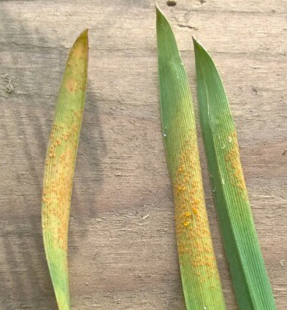
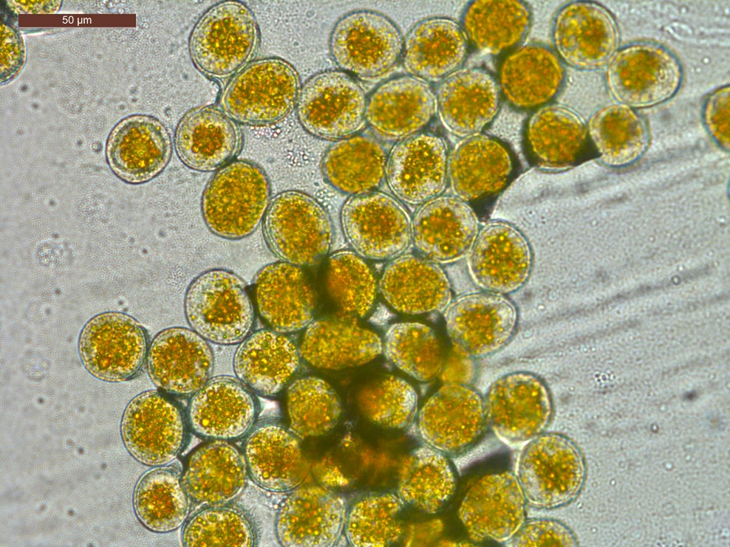
Stripe Rust - Puccinia striiformis f. sp. tritici.
John Rush BASF May 2, 2016
Uredinia don’t form stripes on young plants

Slide 10
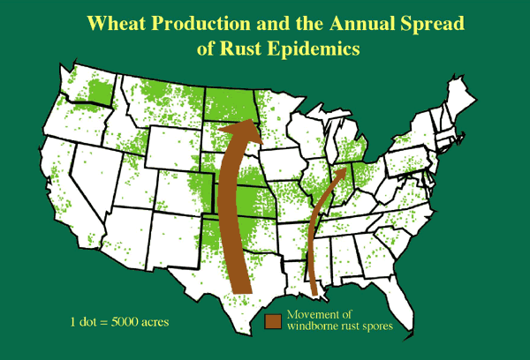
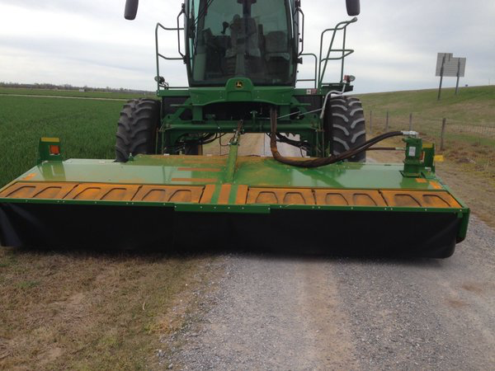
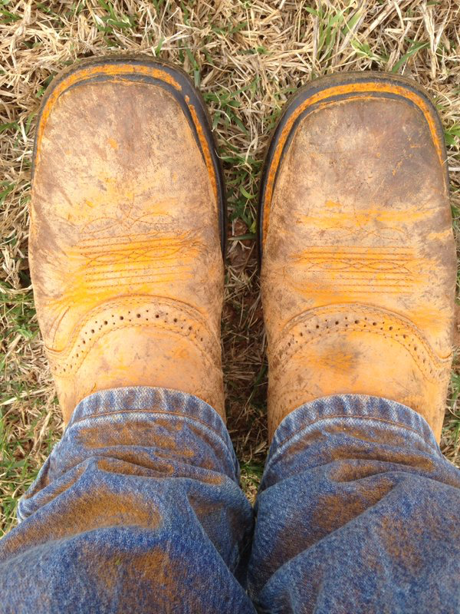
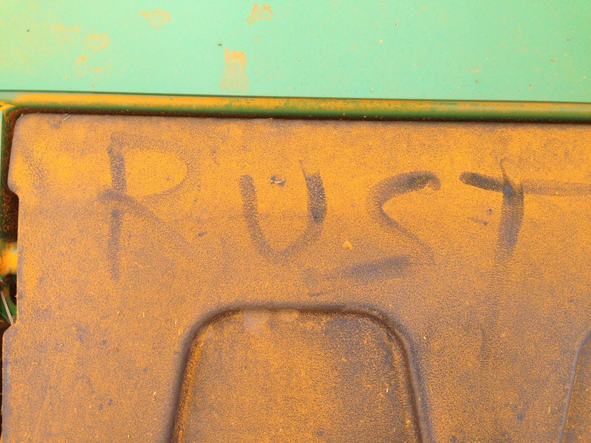
Where did the stripe rust come from?
Overwinter due to mild conditions?
Blown up from southern states?
Kurt J. Leonard, USDA-ARS
Hay cutting at start of April near Chickasha, Oklahoma
Robert Calhoun, Oklahoma State University

Slide 11
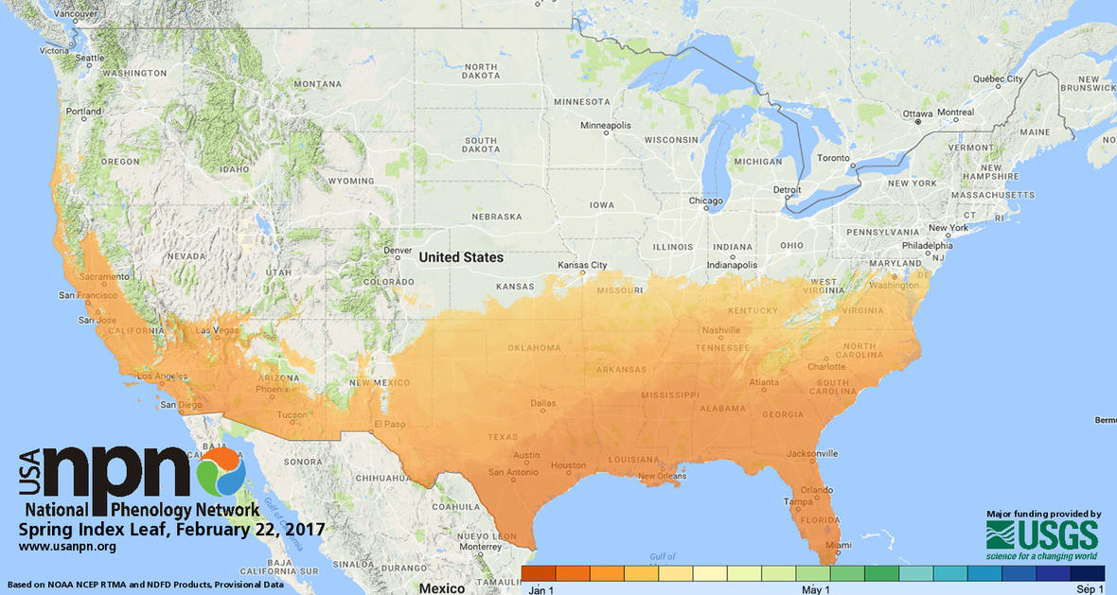
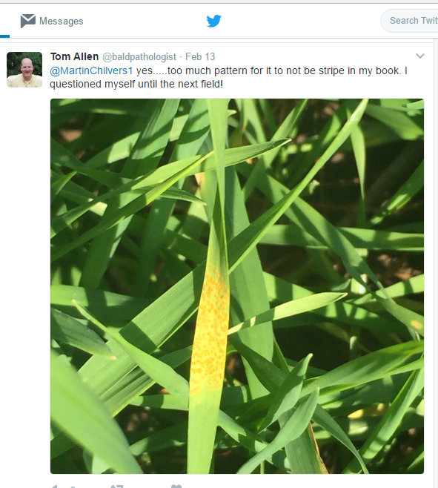
Spring officially starts March 20th
The colour scale down the bottom is broken down into two week blocks. That means that all the coloured parts of the map are already in spring as of 22 February. (sciencealert.com)

Slide 12
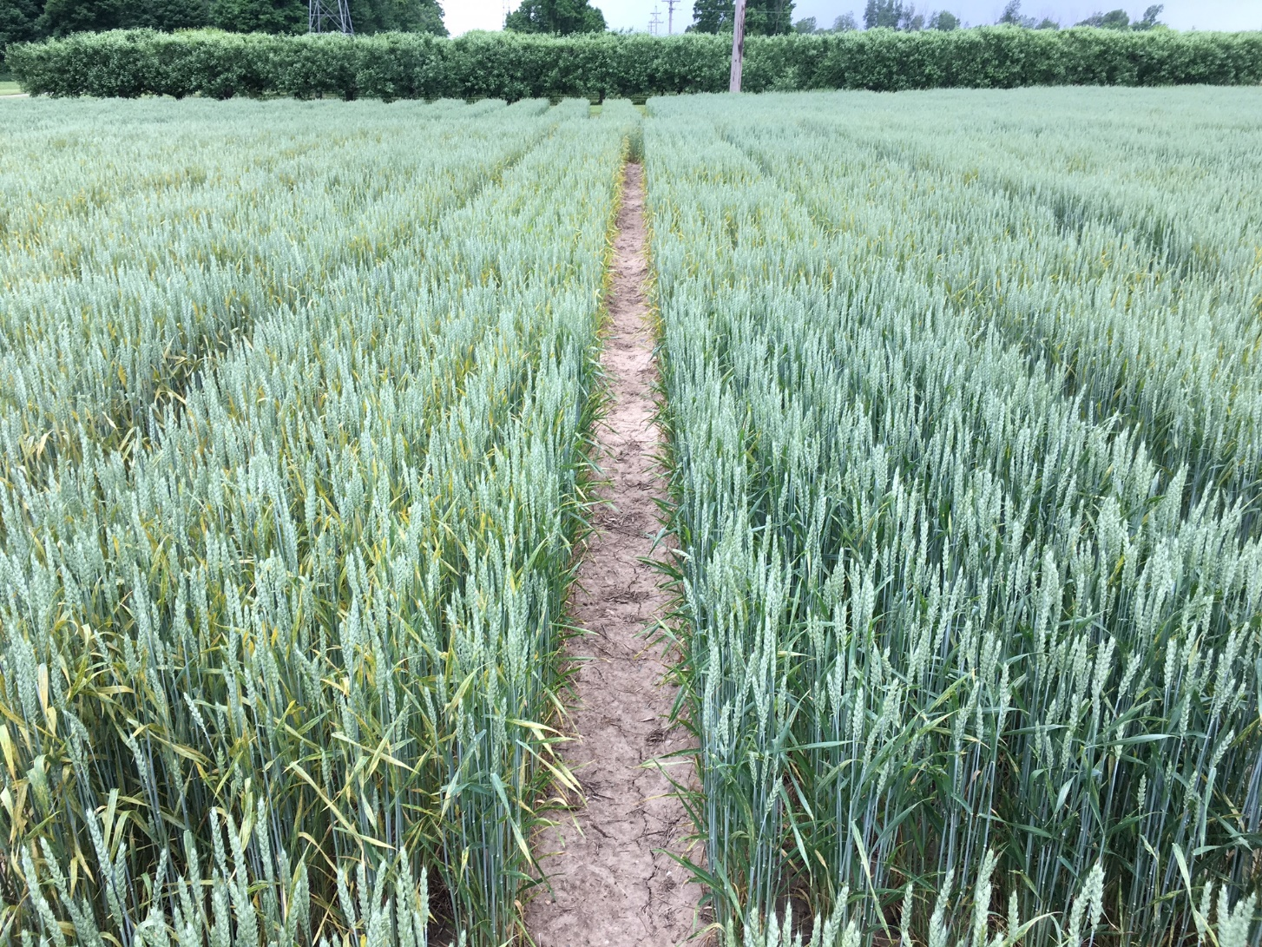
Control vs fungicide at Flag Leaf (Photo: June-6-16)
Timing is everything!

Slide 13
Fungicide Spray Opportunities
Herb
T3
T2
T1

Slide 14
Stripe rust yield response to fungicide timing across trials
T3
T2
T2+T3
Fks6 = first node visible, Apr-22; Fks9 = flag leaf, May-24; Fks10.5.1 = begin flowering, Jun-1
Hot spot in field detected May-24, noted at Mason May-9

Slide 15
www.fieldcroppathology.msu.edu
Class | Active ingredient | Product | Powdery mildew | Stagonospora leaf/glume blotch | Septoria leaf blotch | Tan spot | Stripe rust | Leaf rust | Stem rust | Head scab
Strobilurin | Picoxystrobin | Acapela | G¹ | VG | VG² | VG | E³ | VG | VG | NL
 | Fluoxastrobin | Evito 480 SC | G | -- | -- | VG | -- | VG | -- | NL
 | Pyraclostrobin | Headline | G | VG² | VG² | E | E³ | E | G | NL
Triazole | Metconazole | Caramba | VG | VG | -- | VG | E | E | E | G
 | Propiconazole | Tilt | VG | VG | VG | VG | VG | VG | VG | P
 | Prothioconazole | Proline | -- | VG | VG | VG | VG | VG | VG | G
 | Tebuconazole | Folicur ⁴ | NL | NL | NL | NL | E | E | E | F
 | Prothioconazole Tebuconazole | Prosaro | G | VG | VG | VG | E | E | E | G
Mixed modes of action⁵ | Benzovindiflupyr Propiconazole Azoxystrobin | Trivapro A + Trivapro B | VG | VG | VG | VG | E | E | VG | NL
 | Metconazole Pyraclostrobin | Headline AMP | G | VG | VG | E | E | E | VG | NL
 | Fluxapyroxad Pyraclostrobin | Priaxor | G | VG | VG | E | VG | VG | G | NL
 | Propiconazole Azoxystrobin | Quilt ⁴ | VG | VG | VG | VG | E | E | VG | NL
 | Prothioconazole Trifloxystrobin | Stratego PRO | G | VG | VG | VG | VG | VG | VG | NL
The North Central Regional Committee on Management of Small Grain Diseases (NCERA-184)

Slide 16
Variety | % Infection | Class
L 11528 | 2 | R
SY 100 | 3 | R
AgriMAXX 413 | 1 | R
SY 483 | 2 | R
DF 105 R | 2 | R
Diener 496W | 5 | R
RS 972 | 4 | R
MCIA Venus | 2 | R
Pioneer Brand 25R25 | 5 | MR
Pioneer Brand 25R40 | 5 | MR
AgriMAXX 438 | 5 | MR
Hilliard | 5 | MR
AgriMAXX 444 | 5 | MR
DF 112 R | 5 | MR
9552 | 5 | MR
LCS 2214 | 6 | MR
L-334 | 6 | MR
Jupiter | 16 | MR
MCIA Red Devil | 5 | MR
Equity Brand Butler | 5 | MR
MCIA Red Dragon | 32 | MR
9522 | 5 | MR
DF 109 R | 5 | MR
W 202 | 11 | MR
W 307 | 12 | MR
Sunburst | 14 | MR
9242W | 37 | MR
Variety | % Infection | Class
SC 1335-15 | 10 | MS
TW528-003 | 27 | MS
RS 910 | 22 | MS
Diener 491W | 28 | MS
Pioneer Brand 25R50 | 8 | MS
MCIA Whale | 6 | MS
LCS 3677 | 27 | MS
MSU 6012 | 7 | MS
SC 1315-15 | 14 | MS
AC Mountain | 19 | MS
W 204 | 37 | MS
W 303 | 14 | MS
HS 284R | 34 | MS
L 11418 | 24 | MS
Francis | 21 | S
W 206 | 20 | S
Hopewell | 19 | S
Aubrey | 22 | S
Shirley | 47 | S
SC 1325-15 | 42 | S
L-241 | 19 | S
Ambassador | 39 | S
AgriMAXX 454 | 29 | S
Red Ruby | 50 | S
W 304 | 23 | S
9692 | 18 | S
RS 9XP011 | 37 | S
Skeet | 29 | S
SC 13S26 | 38 | S
Pioneer Brand 25R46 | 38 | S
HS 30.06 | 23 | S
DF 111 R | 52 | S
9491W | 82 | S
Lee Siler¹, Andrew Wiersma¹, Martin Nagelkirk², Eric Olson¹

Slide 17
Stripe Rust Management
Resistant varieties
  Moderate resistant (smaller lesions, fewer spores)
  Highly resistant (few to no symptoms)
Fungicides
  Strobilurins: best if applied preventatively
  Triazoles: best if applied preventatively, but also have post-infection activity. Recommended if stripe rust already present in field.

Slide 18
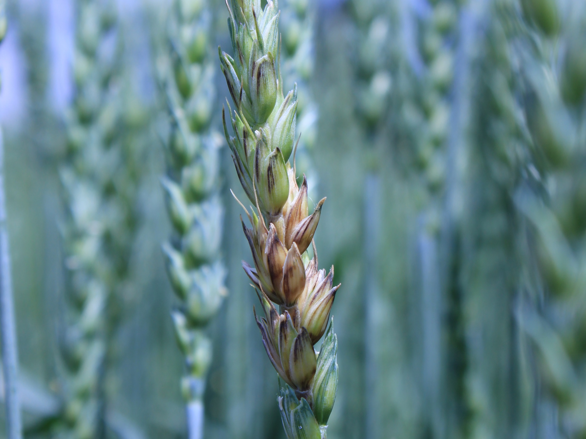


Head scab management

Slide 19
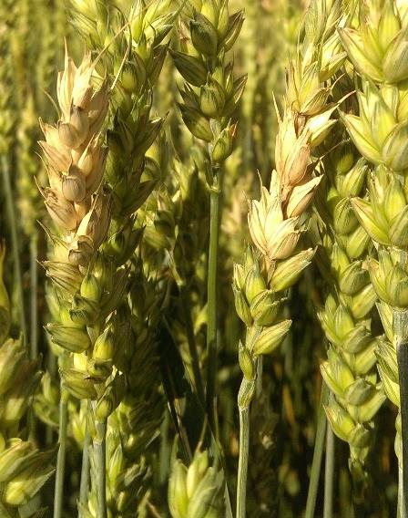
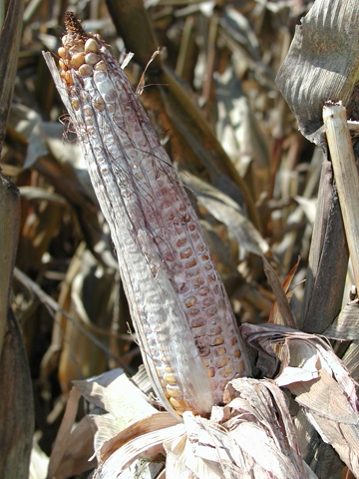

Characterizing population of fungi causing Fusarium head blight
What species are present in Michigan?
  Knowing what fungal species allows us to make the most accurate management recommendations
What types of toxins can they produce?
  DON is the major toxins tested, what about others? (3A-DON, 15A-DON, NIV, ZEN etc)
What level of fungicide sensitivity is present in Michigan populations?
  Is there any resistance in the population?
apsnet.org
Got Samples of Corn or Wheat Grain? breunigm@msu.edu
Notes:
My main project is working to characterize the populations of fungi causing Fusarium head blight, which is a major disease effecting wheat, and can also cause ear rot of corn. It’s not only important because of yield losses, but it also produces toxins can affect both humans and cattle
My goal is to make a collection of isolates of the fungi causing head blight, and figure out first) what species are present so we know exactly what we are dealing with
2) To see what kind of toxins they produce, DON is the major toxin tested by elevators, but are any other being produced? And third) what level of fungicide sensitivity is present, do we have any resistance in the population?
But this summer, fortunately for the producers, but unfortunately for my project, there was very little head scab present. So this is the part where I make a plug for my project and ask for any samples of corn or wheat grain that you guys might have from either this year or years past that could be infected with fusarium or tested high for DON. You can talk to me after this presentation or email me here to coordinate that, it would be very appreciated!

Slide 20
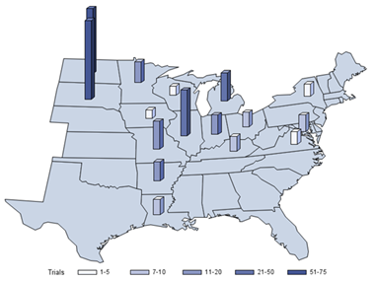
Uniform Fungicide Trials
1995-2013
Which fungicide is the most effective at reducing FHB and DON compared to a non-treated control?
309 trials in total with meta-analyses
All applied at early anthesis (Zadoks 60-65):
  Tebuconazole (generally Folicur, but a few others)
  Proline
  Prosaro
  Caramba
Graphic courtesy Dr. Larry Madden, Ohio State Univ.

Slide 21
Effect of fungicides on FHB
Notes:
2013 - DON

Slide 22
Effect of fungicides on DON
Notes:
2013 - DON

Slide 23
Head scab management trial
4 SWWW varieties:
Ambassador – susceptible check
DynaGro 9242W – partially resistant check
F1014 (line from Dr. Olsen’s program)
E6012 (line from Dr. Olsen’s program)
6 Prosaro fungicide timing treatments:
Non-sprayed, non-inoculated check
Inoculated, non-sprayed check
Fungicide at flowering
Fungicide 2 days post flowering
Fungicide 4 days post flowering
Fungicide 6 days post flowering
Planted 10/17/2014
90 lbs N/A applied at green up
31.24 g of colonized sorghum applied on both 14 & 26 May 2015

Slide 24
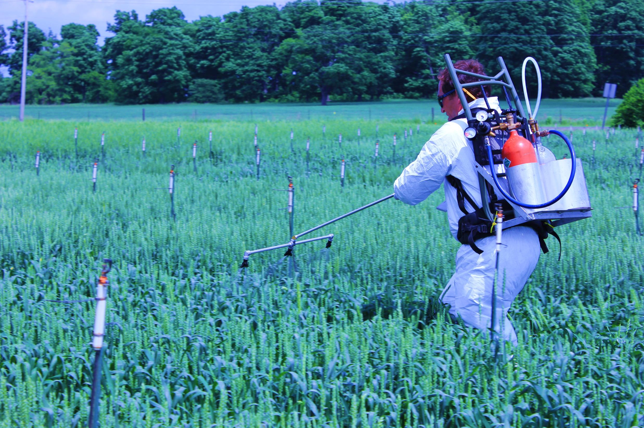
Variety | Flowering date
Ambassador | 6/4/2015
9242W | 6/4/2015
F1014 | 6/8/2015
E6012 | 6/4/2015
TeeJet DG TwinJet nozzles (drift guard twin flat spray tips)

Slide 25
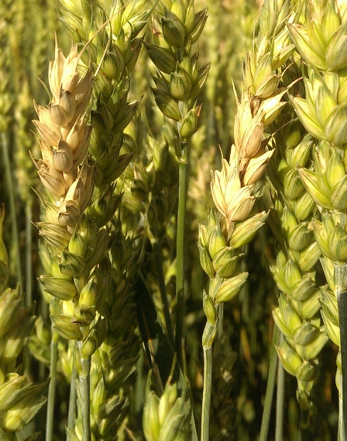
Head Scab disease index (0-100)

Slide 26
3rd Generation Scab Trial
Treatment | Product | Rate | Timing
1 | Untreated check | … | …
2 | Prosaro | 6.5 fl oz/A | Anthesis
3 | Prosaro | 6.5 fl oz/A | Anthesis
 | Caramba | 14 fl oz/A | 4 days after anthesis
4 | Caramba | 14 fl oz/A | Anthesis
 | Folicur | 4 fl oz/A | 4 days after anthesis
5 | Proline | 5.7 fl oz/A | Anthesis
 | Folicur | 4 fl oz/A | 4 days after anthesis
6 | Untreated, non-inoculated check | … | …

Slide 27
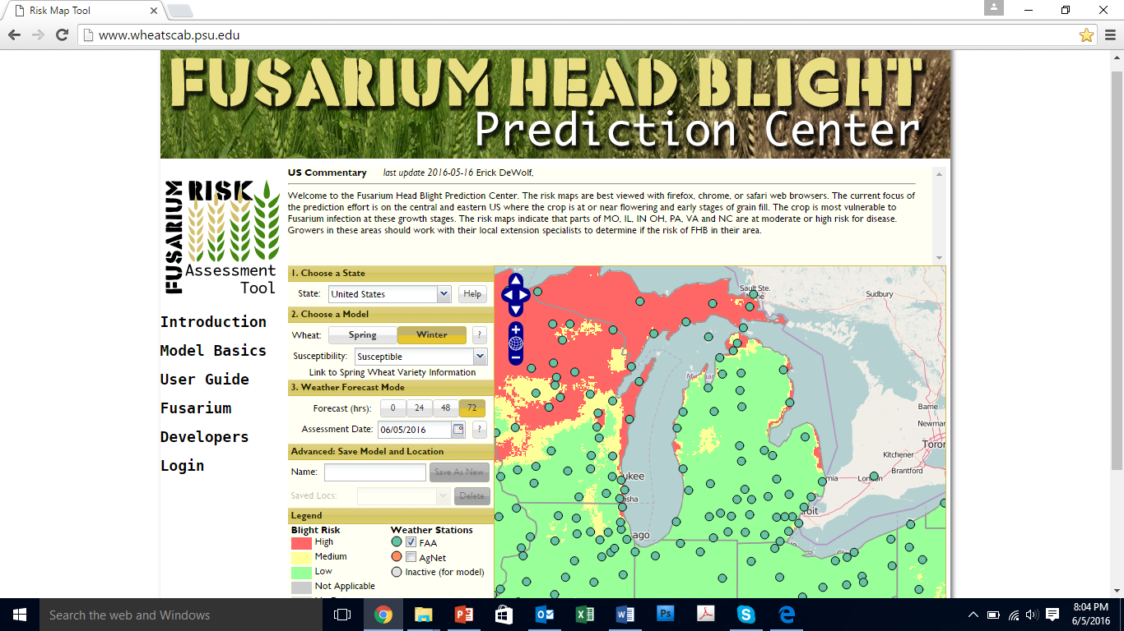
wheatscab.psu.edu

Slide 28

Effect of Headline (6 fl oz/A) applied at different growth stages on DON
2010

Slide 29
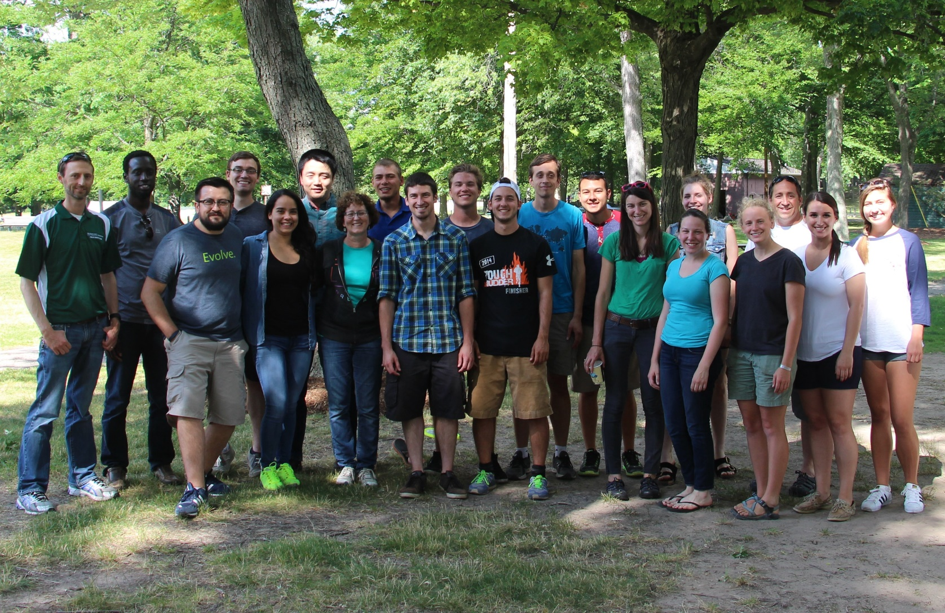








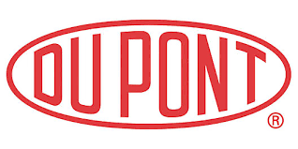






Thank you!
chilvers@msu.edu @MartinChilvers1
517-353-9967
Dr. Carl Druskovich
MSU diagnostic lab, Fred and Jan
John Boyse and Randy Laurenz
Tim Dietz and Kyle Johnson
Kerrek Griffes, Steve Gower - Asgrow
Phil Schneider - GAPS
Karen Zuver – Pioneer
Bill Widdicombe and Lori Williams
Midwest colleagues: Kiersten Wise et al.

Slide 30
Integrated head scab management
Resistant variety
Fungicide app. from flowering to + 6 days
Rotation – avoid planting into corn, and wheat residue

Slide 31
Efficacy of fungicides
www.fieldcroppathology.msu.edu
No strobilurin – can increase DON
Fungicide(s)
Active ingredient | Product | Rate/A (fl. oz) | Powdery mildew | Leaf/glume blotch | Septoria leaf spot | Stripe rust | Leaf rust | Stem rust⁴ | Head scab | Harvest Restrict.
Metconazole 8.6% | Caramba 0.75 SL | 10.0 - 17.0 | VG¹ | VG | VG | E | E | E | G | 30 days
Prothioconazole 41% | Proline 480 SC | 5.0 - 5.7 | --² | VG | VG | VG | VG | VG | G | 30 days
tebuconazole 38.7% | various³ | 4.0 | G | VG | VG | E | E | E | F | 30 days
Prothioconazole19% plus Tebuconazole 19% | Prosaro 421 SC | 6.5 - 8.2 | G | VG | VG | E | E | E | G | 30 days
(source: North Central Region Committee NCERA-184)

Slide 32
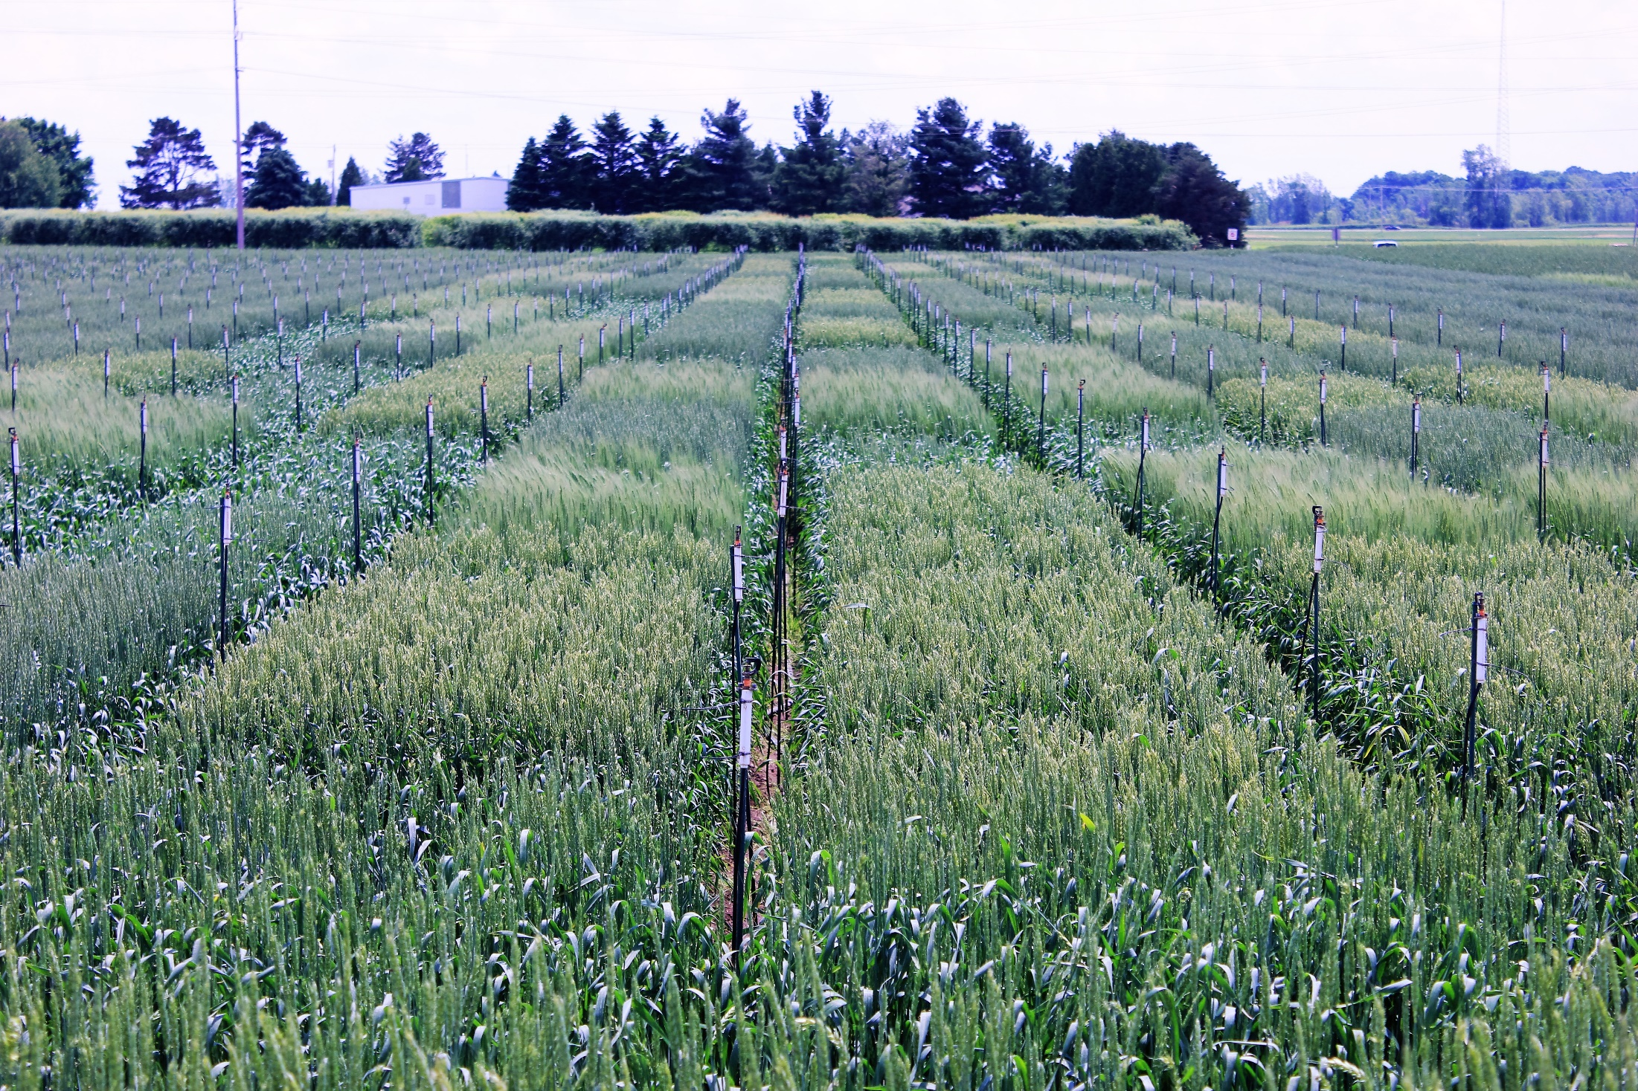
Head scab management trial conclusions
Fungicide up to 6 days post flowering still effective
Application at flowering protects flag leaf
Flag leaf protection increased yield
Efficacy of multiple applications/products?

Slide 33
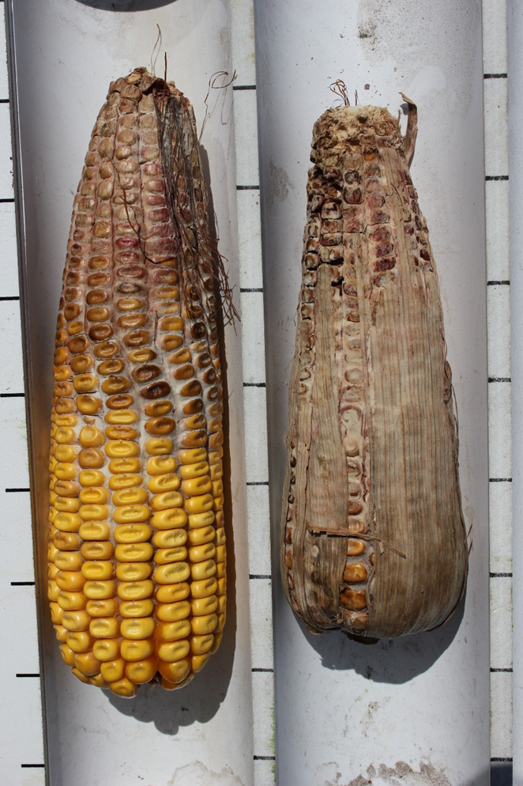
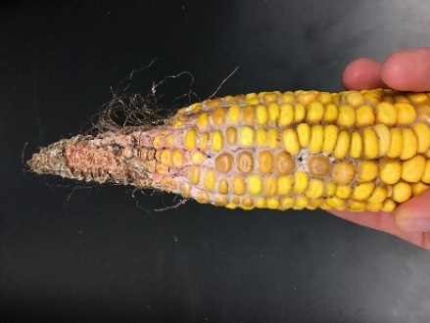
Gibberella and other ear molds
Gibberella zeae = Fusarium graminearum
deoxynivalenol (DON) = vomitoxin

Slide 34
Percentage of fields with DON issues
0%
<5%
>5%
>10%
>20%
>50%

Slide 35
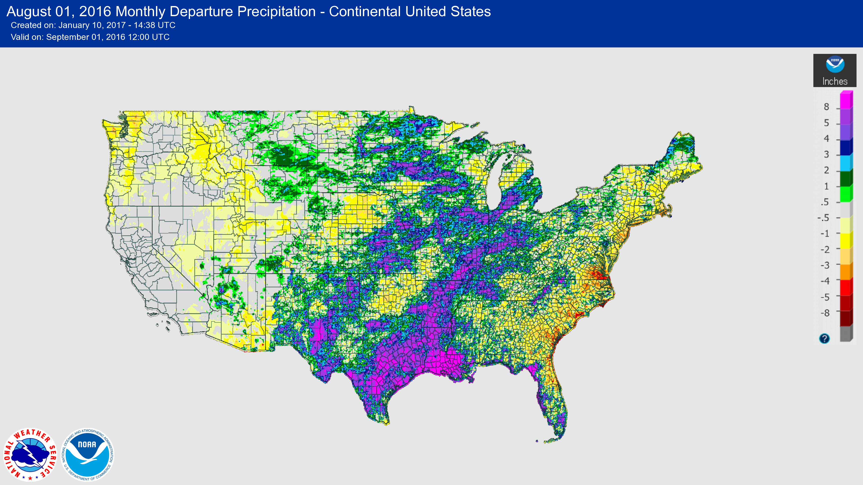
August rainfall departure from normal - 2016
Dry July
Ear tips didn’t pollinate
Silks remained green
WBC

Slide 36
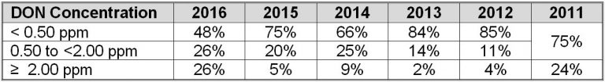
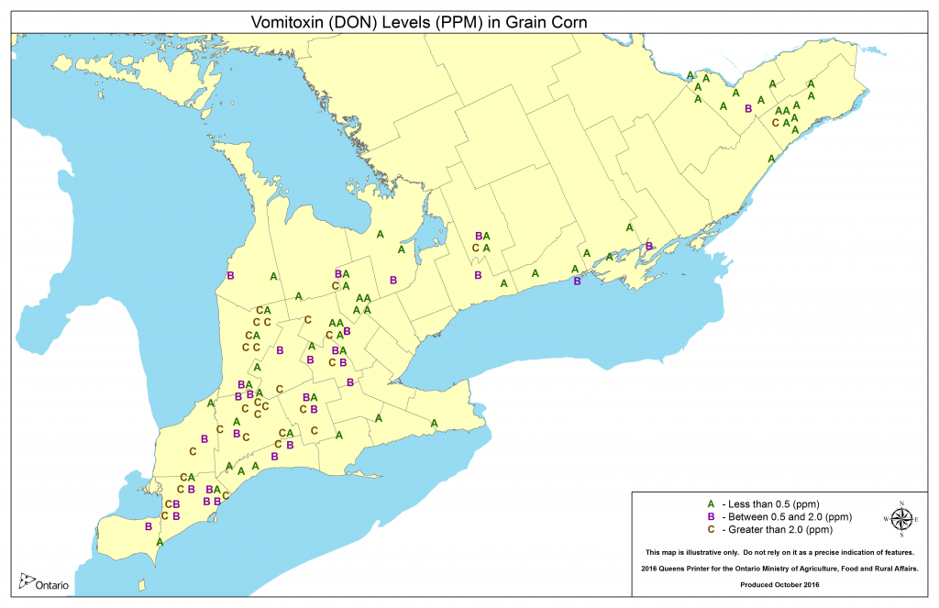
2016 Grain Corn Ear Mold and Vomitoxin (DON) Survey
www.fieldcropnews.com

Slide 37
www.cornmycotoxins.com
Maximum feed levels
End Use | Maximum DON Advisory Levels
Human consumption | 1 ppm In finished products
Swine | 5 ppm (not to exceed 20 percent of ration with finished feed = 1 ppm)
Ruminating beef and feedlot cattle (more than 4 months old) | 10 ppm (not to exceed 50 percent of diet with finished feed = 5 ppm)
Poultry | 10 ppm (not to exceed 50 percent of diet with finished feed = 5 ppm)
All other animals | 5 ppm (not to exceed 40 percent of diet)

Slide 38
Management of ear molds
Select varieties with partial resistance
Avoid corn on corn
Reduce plant stress
Harvest high risk fields first
Dry to 15% moisture
13% moisture for long term storage

Slide 39
Stripe rust observations
May 2 – first reports in thumb
May 9 – found at Mason
May 24 – hot spot in field trial (East Lansing)

Slide 40
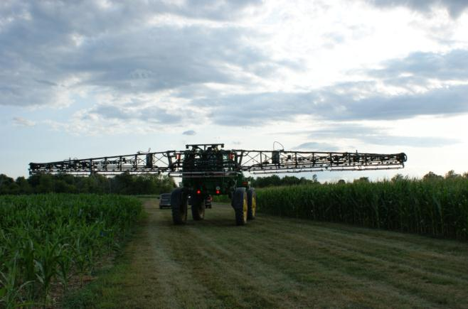
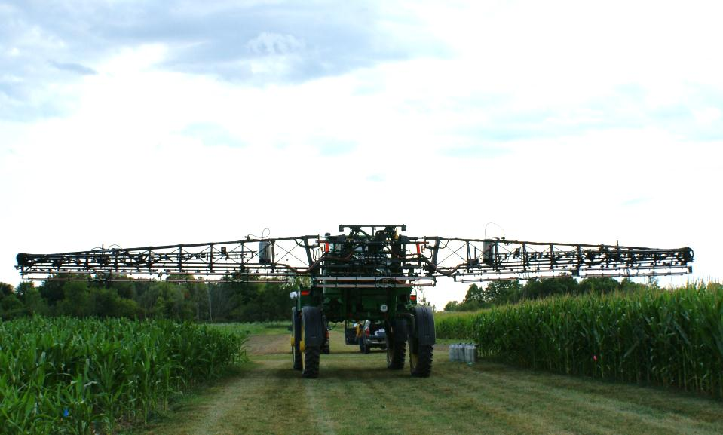
Ear mold management
Farm-scale fungicide application
JD Sprayers Modified for Research starting in 2006
Notes:
40

Slide 41

Effect of crop rotation on wheat head scab & corn gibberella ear rot
Fusarium graminearum = Gibberella zeae
In corn, 3.5-5.5ppm DON following wheat vs. 0ppm following alfalfa
Jeff Krohn, Northern Thumb Crop Consulting Inc.

Slide 42
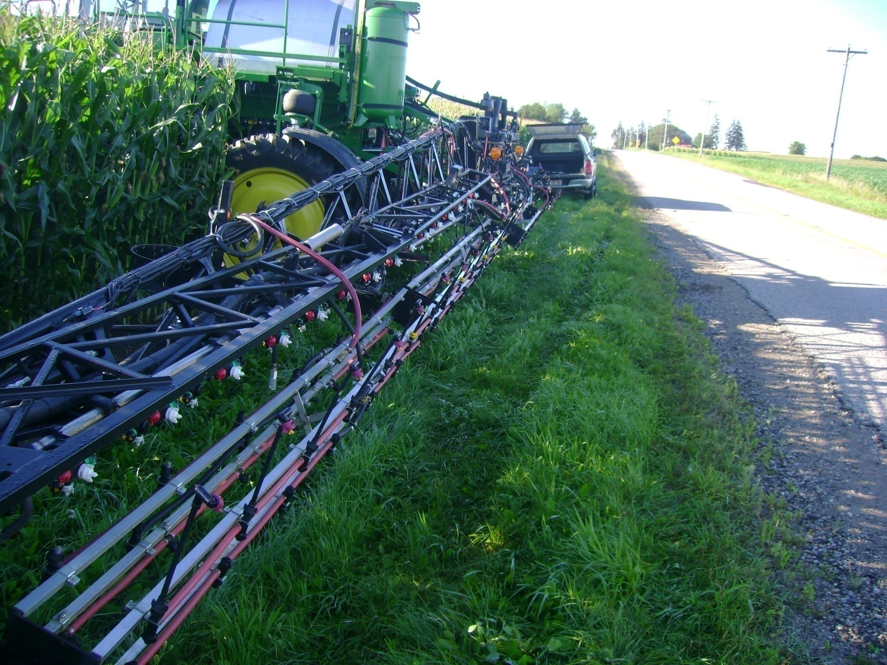
U of G Ridgetown
Research Sprayer

Slide 43
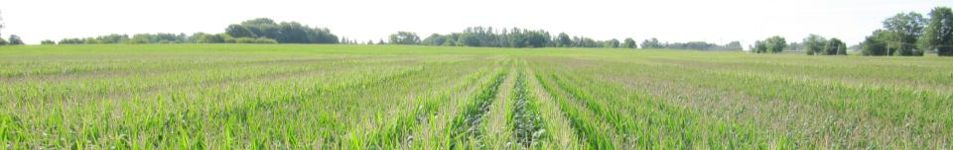
Application Methods on Reducing DON across 3 Farm Fields in 2010
TMT # | CHEM | APPL | GPA
2 | Proline | Above crop | 5
3 | Proline | Above crop | 10
4 | Proline | Above crop | 20
5 | Proline
6 | Proline
7 | Proline
8 | Proline
9 |  | Above Crop | 10
10 |  | Above Crop | 10
DON reduced 20-40%
Various Methods
Ave DON increased, but not statistically different than zero.
Lemay-Rios\Schaafsma – UG Ridgetown
Notes:
43

Slide 44
Application Methods on Reducing DON across 3 Farm Fields in 2010
TMT # | CHEM | APPL | GPA
2 | Proline | Above crop | 5
3 | Proline | Above crop | 10
4 | Proline | Above crop | 20
5 | Proline
6 | Proline
7 | Proline
8 | Proline
9 | Headline | Above Crop | 10
10 | Quilt | Above Crop | 10
DON reduced 20-40%
Various Methods
Ave DON increased, but not statistically different than zero.
Lemay-Rios\Schaafsma – UG Ridgetown
Notes:
Quilt – Azoxystrobin and Propiconazole; Headline - Pyraclostrobin
44

Slide 45
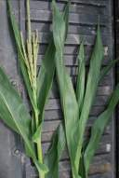
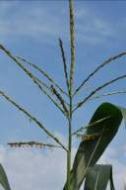
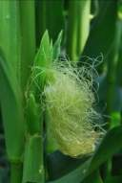
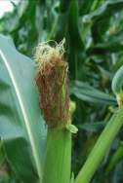
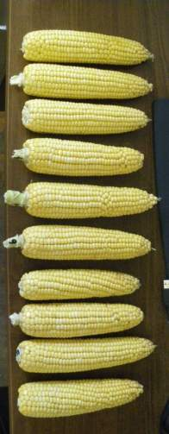
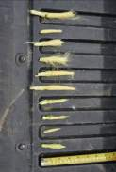
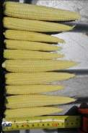
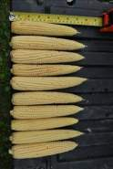
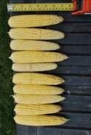
Timing of application
V16-17
Tasseling
Full Silk
Full Silk +5
Full Silk +11
V17 to Early Grain fill about once a week

Slide 46
Field Timing - Ridgetown
Best and most consistent DON suppression occurred with a Proline application at full silking
Proline also has activity on NLB
Lemay-Rios\Schaafsma – UG Ridgetown

Slide 47
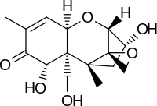
DON (vomitoxin) (ppm)
N.S.
N.S.
High pressure environment: misting every hour for 1 min

Slide 48
DON (vomitoxin) (ppm)
N.S.
P<0.05
P<0.05
N.S.
High pressure environment: misting every hour for 1 min

Slide 49
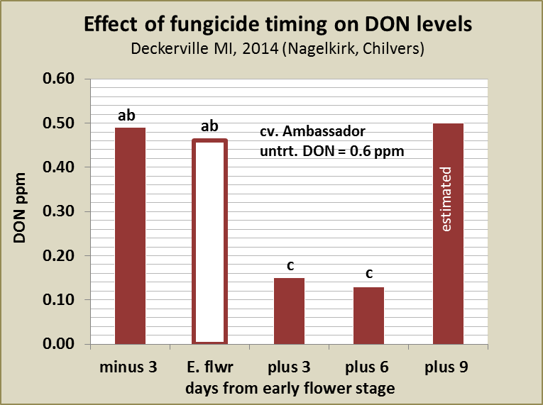
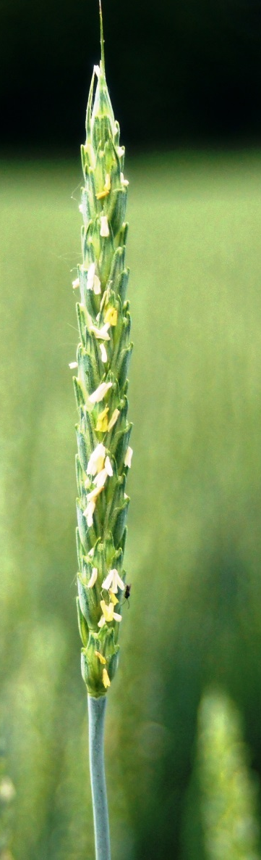
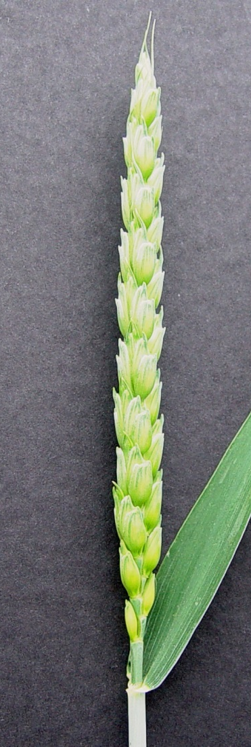

Notes:
In the past, the standard application timing recommendation was to target the early flowering stage (when anthers first become evident). This trial compares head scab and DON levels when Prosaro is applied at heading (see photo) early flowering, or some number of days following early flowering. In 2014, the greatest reduction in DON did not occur with an early flower application. Rather, the best timing was either 3 or even 6 days following the early flower stage. At this point 75 percent or more of the heads had at least one visible anther and some were fully flowered (see right photo). The DON for 9 day application timing is estimated based on fusarium damaged kernels. In 2015, all timings provided a statistically significant improvement over the control treatment. This data, and that from Chilvers and from other collaborating states suggests that the window for a timely application of fungicide extends 3 to 6 days beyond the early flowering stage and that the optimal timing may be a couple days later than previously recommended.

Slide 50

Flag leaf disease (%)

Slide 51
Yield (bu/A)

Slide 52
Corn fungicide conclusions
Variability in data sets and fields
Continue to see best economic response from fungicides when used in response to disease pressure
  VT application
Manage yield and disease control expectations

Slide 53


Field Crops Disease Update
www.CropProtectionNetwork.org
Martin Chilvers
Dep. of Plant, Soil and Microbial Sciences
chilvers@msu.edu @MartinChilvers1
517-353-9967
www.fieldcroppathology.msu.edu

Slide 54
Did you loose yield loss to stripe rust?
0 bu/A
<2 bu/A
<5bu/A
>5 bu/A
>10 bu/A
>20 bu/A

Slide 55


Stripe Rust
Favored by cool night temps <60F (16C)
Infection and disease development rapid at 50-60F (10-16C) *

Slide 56


Other types of wheat rust
Stem rust – Puccinia graminis f.sp. tritici
Leaf rust - Puccinia triticina
Apsnet.org

