Slide 1
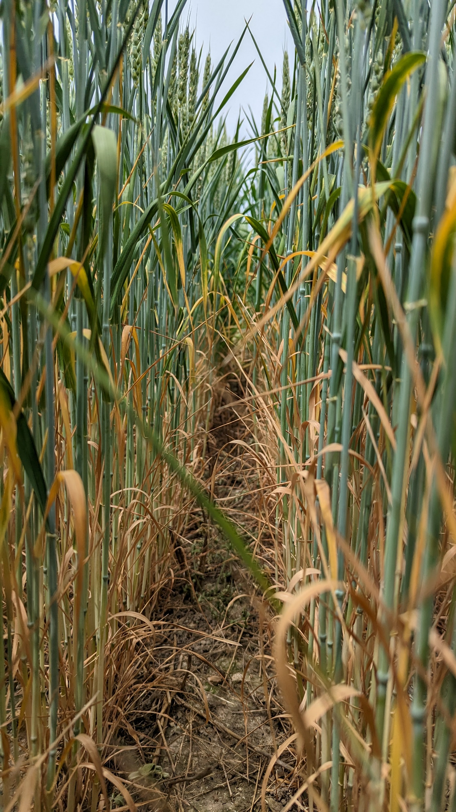
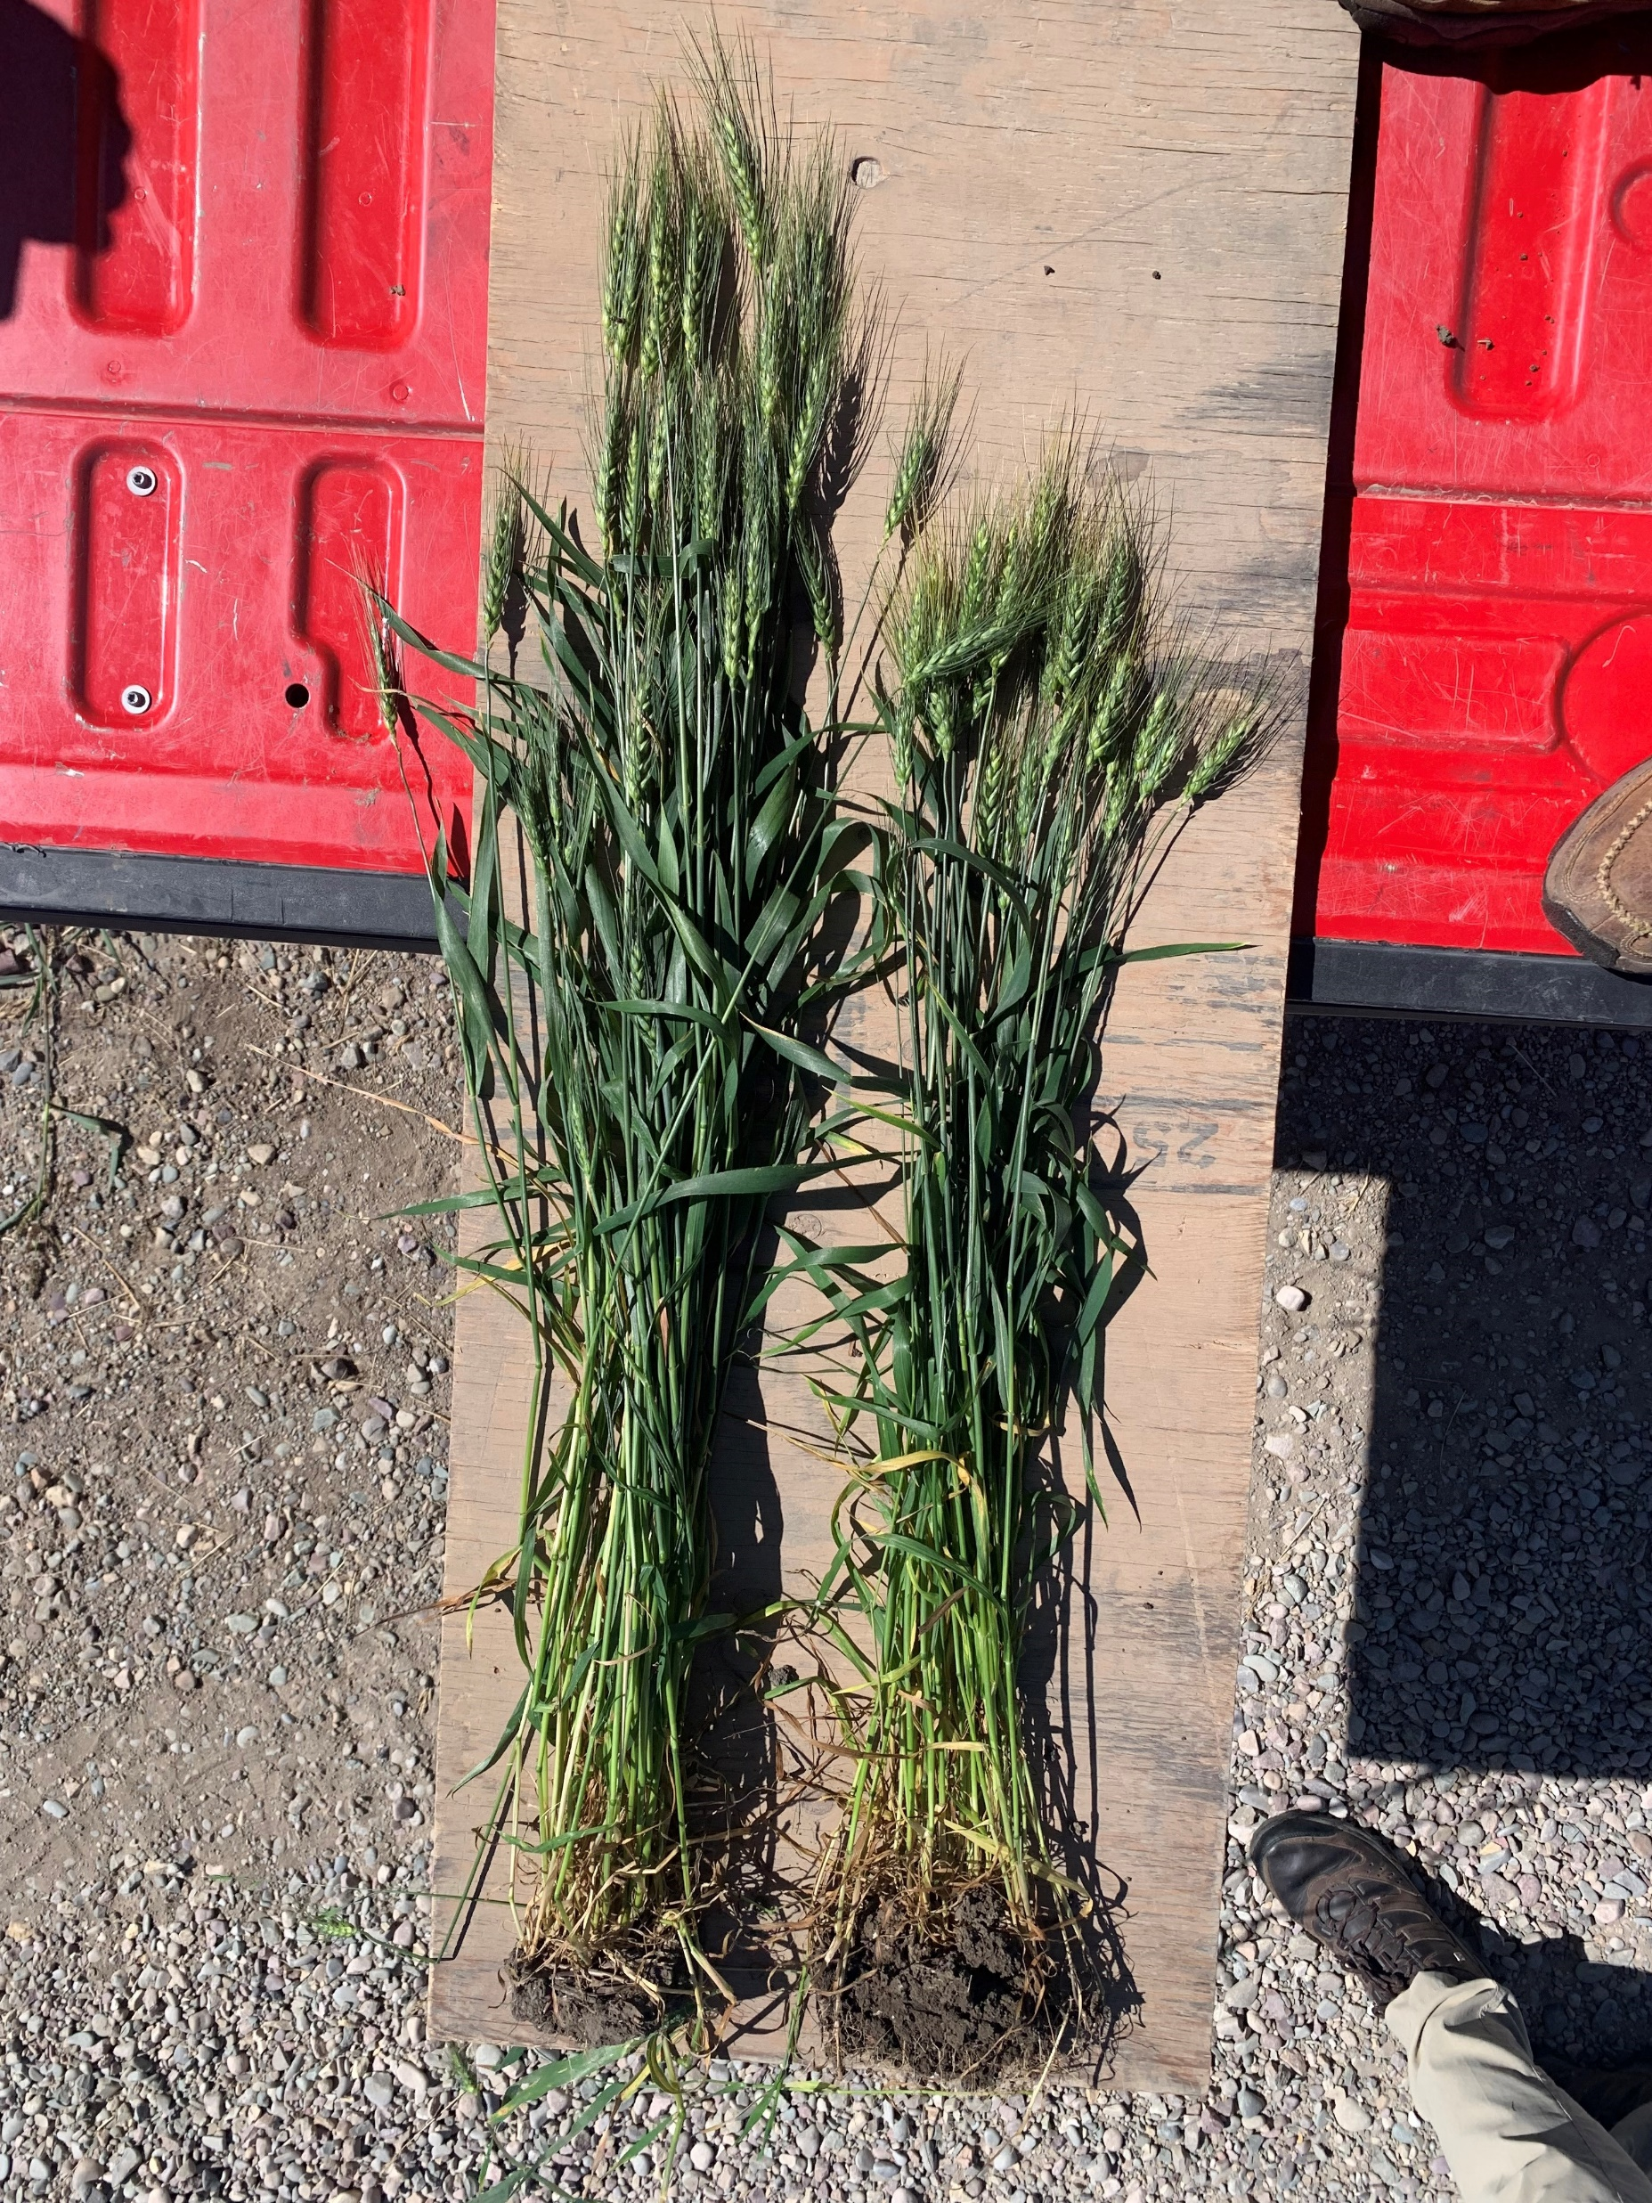
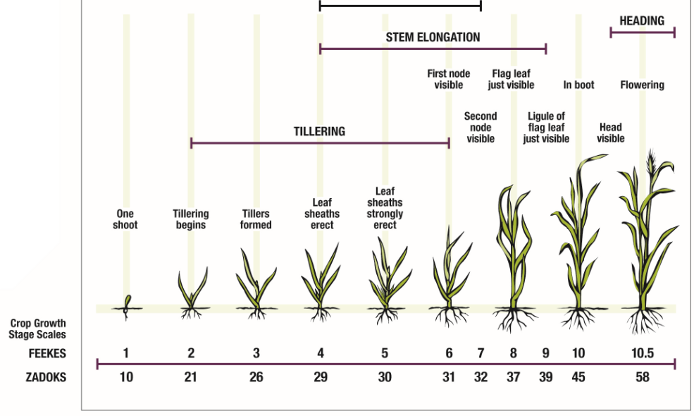
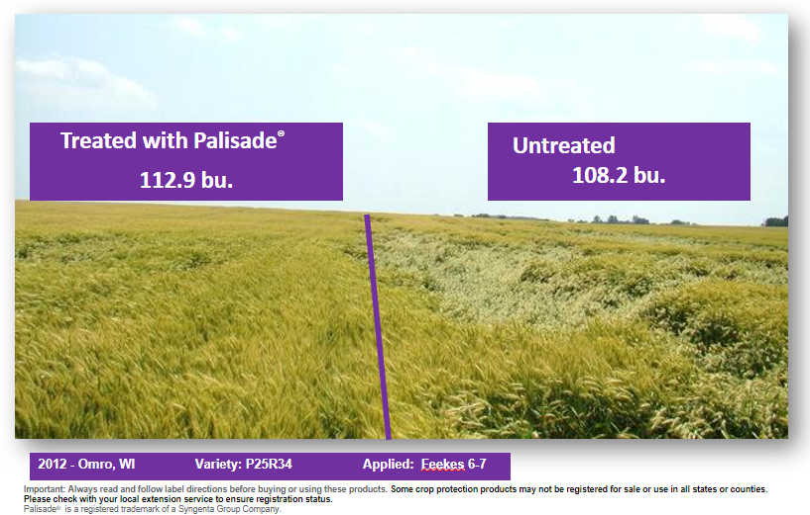
Plant Growth Regulator for
Wheat, Oats, Barley, and Triticale
Dennis Pennington, MSU Wheat Systems Specialist pennin34@msu.edu
What is PGR?
Natural Plant Hormones | Produced in: | Effects
Auxins | Developing Leaves and Stems | Stimulation of early root growth
Cytokinins | Roots and Shoots | Stimulation of cell multiplication in roots and tillers
Gibberellins | Young Tissues | Stimulation of the development of all plant organs, elongation, and division of cells. Inhibition of root and shoot growth
Ethylene | Whole Plant | Blockage of auxins contributing to cell walls thickening and maturation
Abscisic acid | Grain, Shoots, and Fruit | Inhibition of plant growth, ripening
PGR is a Plant Growth Regulator.
Why Use PGRs?
Reduce lodging
Stimulate root development
Reduce apical dominance
Factors to consider for PGRs
Planting date
Seeding rate
Fall tillering
Nitrogen rate
Internode
How PGRs Work
PGRs are similar to plant hormones.
They alter the hormone balance to modify plant
development.
Early plant development
High Auxin levels stimulate rooting
Tiller formation triggers gibberellins
Gibberellins trigger stem cells growth and stem elongation
Use of PGRs in wheat:
Trinexepac ethyl and chlormequate chloride (CCC) blocks synthesis of gibberellic acid responsible for cell elongation
Results in:
Yield Improvement in absence of lodging
Reduced apical dominance → ear-bearing tillers → increased ear number (with proper crop density, fertilization, and disease protection)
Increased root growth, length, and mass
Reduced straw length
Prevention of lodging
Reduced internode lengths
Thicker lignified stems
Increased root growth to strengthen foundations
Maintain grain quality – HFN and test weight
Optimum Application Timing
Untreated vs treated
at Feekes 6
Between Feekes 4 and 7
Best single application time: Feekes 5-7
Best split application time: Feekes 4 and 7
PGR Myths
PGRs do not eliminate lodging in highly susceptible crops – they may delay the onset of lodging or lessen lodging.
In the absence of lodging, PGRs have variable effects on yield sometimes they increase yield, decrease yield, or have no impact
Morphological effects are accompanied by alterations in developmental and physiological behavior
The green color of foliage is intensified
An extended longevity of plants has been regularly observed, retardation of senescence (Source: Grossman, 1992; Berry et al., 2004)
Optimum temperatures are generally above 41 degrees Fahrenheit (Berry et al., 2004)
Temporary, short term height reduction (Rajala and Peltonen-Sainio, 2002)
Increased tillering; potentially late unproductive tillers
Reduced grain weight (Rajala and Peltonen-Sainio, 2002)
Thanks to Syngenta and Eastman Company for supplying data and images.

