Slide 1
Feeding Treated Wheat Straw (Beneficial Fiber) to Young Pigs
Dale W. Rozeboom
Professor/Extension Specialist/Associate Chair
Department of Animal Science
Michigan State University
Funding Request Presentation
Michigan Wheat Committee Research Meeting
August 21, 2018
Funding Report Presentation
Michigan Wheat Committee Research Meeting
August 25, 2020; August 30, 2021

Slide 2
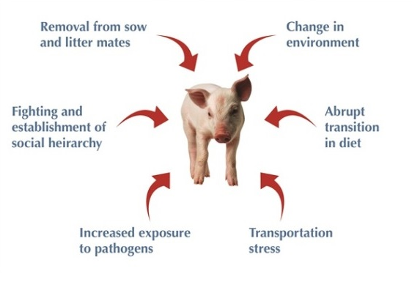
Health and performance effects of weaning
Impaired gut barrier,
disease, reduced feed intake,
stunted growth
No more feed-grade
antibiotics for the purpose
of ‘growth promotion’
National Hog Farmer
Notes:
Weaning is the most stressful, traumatic event of the pigs life. Lots of factors leading to negative effects in the gut, health, and performance. Anything we can do during this time will either set the pig up for success or failure in the future.
Lots of factors affect the pigs health during weaning. Increased restrictions on antibiotics makes management of health during weaning a greater challenge

Slide 3
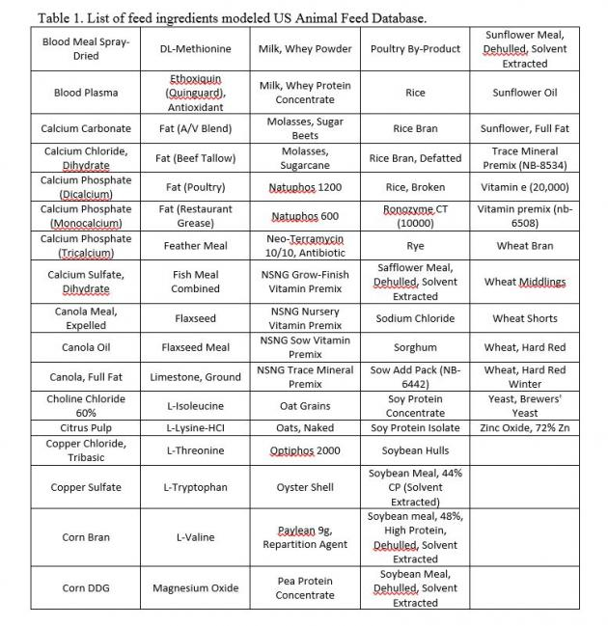
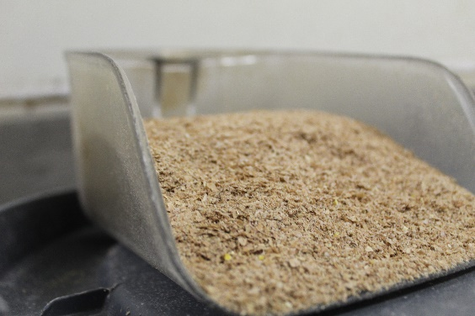
Nutrition - strategic use of feed ingredients, nutrients, and additives to stimulate gut health and performance
Additives
  Pre and probiotics, organic acids, anti-microbial peptides
Protein
  Fish meal, spray-dried plasma, synthetic amino acids
Carbohydrates
  Whey
Fiber
/lpelc.org
Notes:
There are many researched alternatives to antibiotics, all showing potential, but each with downsides. There are ways to alter for performance, better utilization, but also cost analysis and available feedstuffs. Some parts of world do not have same availability as U.S. industry.
Fiber is one such feedstuff beginning to emerge as potential in many ways

Slide 4
Dietary fiber – detrimental or beneficial
Increased fiber content leads to:
  Lower energy density
  Increased feed intake
  Decreased growth rate and feed efficiency (Swine Nutrition 2nd edition, 2001)
Hedemann et al., (2006) barley hulls led to changes in morphology, increased villi height
Zhang et al., (2016) dehydrated alfalfa, altered gut microflora and pathogenic suppression
Liu et al., (2018) corn bran increased plasma IL-10, decreased inflammation and antigen presence
Notes:
Hedemann – increased villi height in duodenum, slight increase in ADG, ADFI (wheat and barley flour based, barley hulls as fiber)
Zhang – altered microflora populations, reduced pathogenic load
Liu- decreased inflammation, enhanced immunity, less maintenance energy

Slide 5
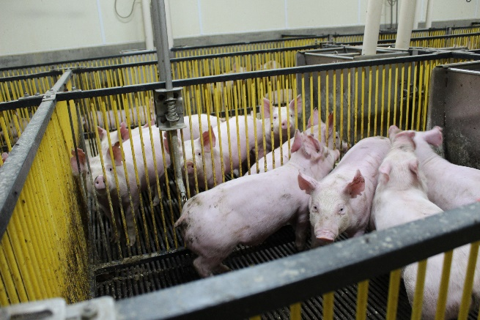
Lewton et al., (2019)
Treatment of wheat straw enhances utilization of nutrients, when maintaining dietary energy.
Improved feed efficiency and decreased average daily feed intake with the addition of treated wheat straw appears to suggest that treatment of the fibrous feedstuff increases dietary net energy.
When included in the nursery pig diet, treated wheat straw impacts immune function and inflammatory response, leading to benefits in health and performance.
Lewton, J.R., M.A. Michael, Mrigendra Rajput, K.M. Thelen, A.J. Moeser, D.W. Rozeboom. 2019. Feeding treated wheat straw to weaned pigs improves feed efficiency and impacts mucosal and system immune parameters. J. Anim. Sci. Vol. 97, Suppl. 3:123–124, https://doi.org/10.1093/jas/skz258.255.
Notes:
Our next step is to better understand the effects of both treated and untreated wheat straw on the gut health and performance of nursery pigs, as well as the long term effects of implementing a high % of dietary fiber in the nursery pig diet.

Slide 6
Treatment Protocol
1 kg wheat straw
Mixed with 1750 mL water and 250 mL H₃PO₄
Mixture heated to 100⁰ C, under pressure
Buffered with 125 g CaCO₃
Drying and grinding process
Swelling and separation of the cellulose
Partial removal of lignin
Hydrolysis of the hemicellulose
Glucose and lipid released, improving nutritive value
Notes:
Adaptation of chemical-thermomechanical methods of Michael (2016), which were based on work El-Husseiny et al. (2006) and Bergner et al. (1978).
Treatment causes swelling and separation of the cellulose, partial removal of lignin, lowering of the crystallinity of the cellulose fraction, and partial hydrolysis of the hemicellulose by disruption of bonds in the lignocellulosic complex and within the cellulosic fraction, consequently improves the nutritive value of wheat straw.

Slide 7
Goal and hypotheses
We did not compare untreated wheat straw
  Do not know if the benefit to gut health may be a result from untreated straw alone, or if it may also be a result of the treatment of the straw
Goal:
  To determine the effect of untreated wheat straw in nursery diets on growth performance, intestinal development, and health of weaned pigs.
Hypotheses
  Dietary untreated wheat straw (5%) will decrease growth performance slightly but will provide gut health benefits.
  The growth and gut health benefits of feeding 5% dietary treated wheat straw will be confirmed.

Slide 8
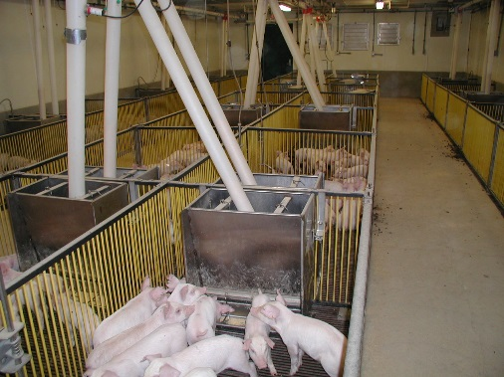
Methods – animals and housing
All research conducted in one of four mechanically-ventilated nursery room at Michigan State University Swine Farm
192 crossbred (PIC 359 x Yorkshire), mixed sex pigs were
  Weaned at 28 d (8±1 kg)
  Randomly allotted based on litter and sex
24 (1.22 x 1.83 m ) pens
8 pigs per pen (4 per sex)
Three treatments
  Basal (control)
  5% untreated wheat straw (UWS)
  5% treated wheat straw (TWS)

Slide 9

Lauwers Alfalfa & Straw Farms
Capac, Michigan
https://superiorforage.com/#home

Slide 10
Treatment Protocol
1 kg wheat straw
Mixed with 1750 mL water and 250 mL H₃PO₄
Mixture heated to 100⁰ C, under pressure
Buffered with 125 g CaCO₃
Drying and grinding process
Untreated wheat straw was heated to 122°F for one hour
Notes:
Adaptation of chemical-thermomechanical methods of Michael (2016), which were based on work El-Husseiny et al. (2006) and Bergner et al. (1978).
Treatment causes swelling and separation of the cellulose, partial removal of lignin, lowering of the crystallinity of the cellulose fraction, and partial hydrolysis of the hemicellulose by disruption of bonds in the lignocellulosic complex and within the cellulosic fraction, consequently improves the nutritive value of wheat straw.

Slide 11
Methods - Treatments
Imposed over three nursery phases (I, II, and III; 7, 7 and 14 days, respectively):
Diets were similar to those commonly used by the industry
  Corn, processed soybeans, animal products, minerals and vitamins
  Meeting or exceeding nutrient requirements of NRC (2012)
    Dietary Cu and Zn not pharmacological concentrations
  Isocaloric using dextrose; keeping supplemental fat content similar across treatments
No antibiotic

Slide 12
Methods – data and sample collection
Gain, feed intake, feed efficiency determined weekly
Nursery mortality and morbidity
Blood samples (5 mL) collected, jugular venipuncture
  Day 28
  One pig randomly selected from each pen, with consideration of sex
  Analyzed for systemic immune marker IgA
Ileal and colonic mucosa samples were collected on d 28
  Sacrifice of one pig randomly selected from each pen, with consideration of sex
  Mucosal cytokines: TNFα, IL-12, IL-6, IL-10
Notes:
Systemic immunity measured using PBMCs – peripheral blood cell having a round nucleus… cells left after removing blood plasma, it includes lymphocytes, monocytes) and does not include red blood cells or platelets
MHC II =marker located on antigen presenting cells, aids in pathogenic recognition and response
Local immunity markers (cytokines) in the mucosa from scraping –pro/anti inflammatory
TNFalpha, IL-12 are proinflammatory markers of immunity, IL-6 is both pro/anti inflammatory, IL-10 is anti-inflammatory they all aid in acute phase immune response and inflammatory response

Slide 13
Nutrient constraints
 | Phase 1 (d0-7) | Phase 2 (d7-14) | Phase 3 (d14-28)
NE, Kcal/kg | 2474 | 2474 | 2474
Fat, % | 3.66 | 4.08 | 4.76
SID Lys, % | 1.35 | 1.30 | 1.25
SID Met, % | 0.47 | 0.46 | 0.45
SID Thr, % | 0.85 | 0.82 | 0.79
Ca, % | 1.04 | 0.93 | 0.80
AvP, % | 0.77 | 0.69 | 0.59
Notes:
These were the values we were shooting for.
The goal was to formulate an isocaloric diet across the 3 treatments (within each phase), maintaining SID AA % and Ca and P

Slide 14
Phase 1 Diets (d 0-7)
Ingredient Detail: As Fed Phase 1 (d0-7)
Notes:
TWS was at 5 and 10%, fixed ingredients were: whey, oats groats, blood meal, bakery waste, micropremix, plasma….and we adjusted corn and SBM as well as AA, we added corn oil to maintain an isocaloric diet on an ME basis., Mono cal. and calcium carbonate were also affected by the treatment, addition decreased as we added more TWS

Slide 15
Project timeline
January 1, 2019 to December 31, 2019
  Original grant dates
July 9, 2019
  No-cost extension granted through December 31, 2020
    Because of smaller than anticipated farrowing groups at MSUSF and because of other studies that were slated ahead of our study
April 13 – May 11, 2020
  Granted “Essential” status by MSU, so that study could be conducted at MSUSF
July 1, 2020
  MSU approves Individual Lab Safety Plans and laboratories accessed once again

Slide 16
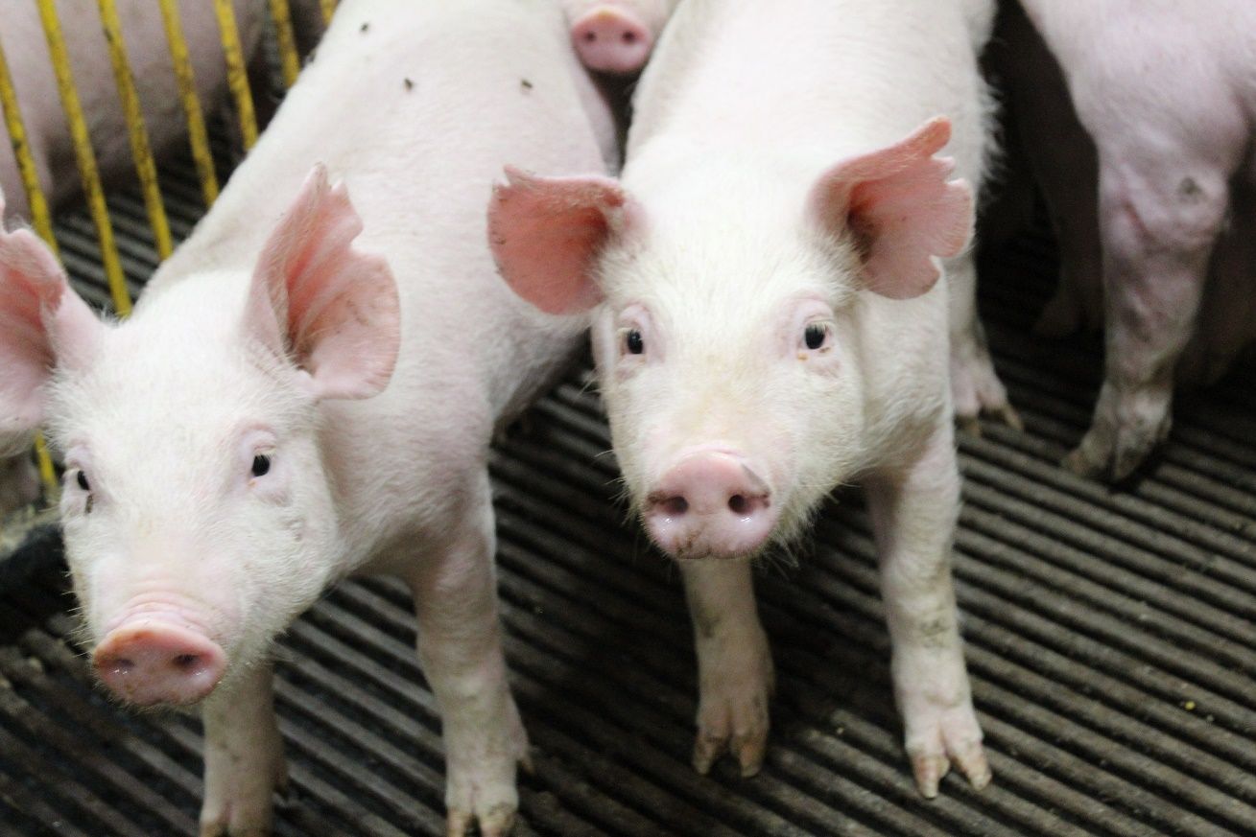
Results

Slide 17
Analyzed composition of treated and untreated wheat straw (2020)
Item | Untreated wheat straw | Treated wheat straw
Moisture, % | 4.47 | 5.68
Crude protein, % | 2.12 | 1.66
Crude fat, % | 1.03 | 4.05
Ash, % | 6.67 | 28.73
Calcium, % | 0.249 | 4.55
Phosphorus, % | 0.077 | 9.09
Lys, % | 0.10 | 0.07
Met, % | 0.04 | 0.03
Thr, % | 0.08 | 0.05
Notes:
These are our analyzed values, but prior to this we had no previous analyzed values for either.
In each of the following few slides, ingredients are in the left column with untreated and treated wheat straw analyzed values of each. As you can see, with treatment, GE decreased, however crude Fat increased, which most likely indicates a release of fat (fiber bound) from the wheat straw in addition to sugars during the treatment process.
Ca and P and Ash went up with treatment as well, due to phosphoric acid and calcium carbonate included at high % of treatment method.

Slide 18
Analyzed composition of treated and untreated wheat straw (2020)
Item | Untreated wheat straw | Treated wheat straw
Crude fiber, % | 42.92 | 29.84
NDF | 78.66 | 42.41
ADF | 54.63 | 39.75
Hemi-cellulose | 24.03 | 2.66
Total dietary fiber | 90.12 | 49.85
Notes:
As you can see, there is a significant decrease in hemi-cellulose with the treatment, which along with other components accounted for in ADF and NDF, lead to a great decrease in TDF, TSDF, and TIDF… a demonstration of the breaking of bonds and freeing up of available nutrients bound in the fiber

Slide 19
Growth performance of nursery pigs
Item | CON | UWS | TWS | SEM
BW, kg
Initial | 8.30 | 8.30 | 8.31 | 0.205
Final | 19.83 | 19.26 | 19.81 | 0.205
ADG, kg
Wk 1 | 0.17 | 0.17 | 0.18 | 0.010
Wk2 | 0.34 | 0.32 | 0.32 | 0.010
Wk3 | 0.50ª | 0.45^{b} | 0.51ª | 0.016
Wk4 | 0.64 | 0.63 | 0.63 | 0.023
Overall | 0.41 | 0.39 | 0.41 | 0.010
ADFI, kg
Wk 1 | 0.27 | 0.26 | 0.26 | 0.012
Wk2 | 0.45 | 0.44 | 0.44 | 0.015
Wk3 | 0.74 | 0.69 | 0.70 | 0.021
Wk4 | 0.98 | 0.96 | 0.96 | 0.024
Overall | 0.61 | 0.59 | 0.59 | 0.015
G:F
Wk 1 | 0.62ª | 0.63ª | 0.71^{b} | 0.020
Wk2 | 0.76 | 0.72 | 0.73 | 0.014
Wk3 | 0.69ª | 0.66ª | 0.72^{b} | 0.011
Wk4 | 0.65 | 0.66 | 0.65 | 0.014
Overall | 0.68^{abx} | 0.67^{b} | 0.70^{ay} | 0.008
^{ab}Values in a common row lacking a common superscript differ (P < 0.05) ^{xy}Values in a common row lacking a common superscript differ (P < 0.10)

Slide 20
Circulatory, ileal and colonic mucosal health markers
 | 2018 |  |  | 2020
Item | Control | Treated wheat straw 5% | Treated wheat straw 10% | Control | Untreated wheat straw | Treated wheat straw
Plasma Ig-A | 0.468^{ab} | 0.525ª | 0.351^{b} | 0.482ª | 0.478ª | 0.728^{b}
Ileum
TNF-α |  |  |  | 1.0 | 0.69 | 0.80
IL-6 |  |  |  | 1.0ª | 0.12^{b} | 0.27^{b}
IL-12 |  |  |  | 1.0ª | 0.64^{b} | 0.78^{b}
IL-10 |  |  |  | 1.0 | 0.81 | 0.96
Colon
TNF-α | 1.0ª | 0.84^{ab} | 0.20^{b} | 1.0 | 1.12 | 1.24
IL-6 | 1.0 | 0.67 | 0.49 | 1.0ª | 0.41^{b} | 0.65e
IL-12 | 1.0ª | 0.37^{ab} | 0.22^{b} | 1.0 | 1.19 | 1.10
IL-10 | 1.0 | 1.10 | 1.50 | 1.0 | 1.02 | 0.81^{f}
Notes:
Feeding 5% treated wheat straw increased plasma Ig-A in our second study, but it had not changed this immunoglobin in our first study. Proinflammatory cytokine TNF-α was less in colon in study 1. Proinflammatory cytokine IL-6 decreased in the ileum and colon mucosa with the feeding of treated and untreated straw. Ileal IL-12 was also decreased by feeding straw. TNF-a in colon mucosa did not differ in the second study, as it did in the first. Feeding 5% treated wheat straw increased plasma Ig-A in our second study, but it had not changed this immunoglobin in study.

Slide 21

Impact or significance of proposed research
This research is additional proof that wheat straw benefits pig health
  Resistance from use of feed-grade antimicrobials could be alleviated
  Stronger consumer trust in pork quality and safety
  Achievement of desired growth performance of pigs
  Swine farm profitability
    Cost of straw treatment

Slide 22
Future Work
Proposal submitted to Michigan Pork Producers Association on June 8, 2021
  $25,000
    Net energy
    Health benefits
    Graduate student
  The MPPA Board was more interested in the health benefit objectives
    Requested revision
    Presentation September 8, 2021
    More intensive investigation of the immune modulating properties of treated wheat straw by characterizing immune cell phenotypes and lymphoid organ development and perhaps carrying the animals out to finishing to evaluate longer term benefits.

Slide 23

Thank You
Notes:
Results:
-changes in cytokines and decreased feed intake …. Inflammation was decreased (decreased TNF alpha, IL-12, increased IL-10)… fiber is known to have a “fill effect”, pigs had decreased intake due to a full feeling, yet still had some ADG and energy utilization, etc.
-increase when stimulated with LPS… outside of body, no interaction of other cytokines, MHC II levels were slightly higher and were reflected in an amplified response when presented with challenge (PBMC’s may have greater reaction to antigens than normal antigen presenting cells in the gut)
-Morphology not changed… we know there was an effect of some kind, just not structurally, but could be related (VFA, microbiome, greater fermentation and available energy)
-wheat treatment methods/effects on our results…. The treatment may have been part of our results, acid treatment may have had some affect on the GIT that was not necessarily due to wheat straw. This is our next objective.
-prebiotic effect-altering microbiome – the fiber may have fed some of the microbes in the gut, increasing specific populations and competitively excluding others, leading to increased utilization of nutrients, greater gut stimulation and less presentation of antigens
-VFA’s – fiber is known to increase fermentation in the hindgut, this leads to increase production of VFA’s which play a significant role in total energy utilization, may have resulted in more available energy and uptake, requiring less feed for maintenance and growth
-use in industry – wheat straw is relatively inexpensive, used primarily as bedding or fertilizer plowed back into field. Treatment may raise price, but still economical and could be even greater utilized if effective without treatment. We have yet to learn the log term effects of pigs supplemented in nursery as they move to grow-out and finisher.
-IgA- More data analyzed since abstract published. Less conclusive result. IgA=antibody role in immune function of mucosal membrane, much more present in mucosa than blood serum, but was not evaluated in mucosa.
-Wheat straw components (g/kg DM): hemicellulose=319, cellulose=289, sDF=15 isDF=838, TDF=853
-

Slide 24
Budget
July 29, 2020 Budget Revision Request: $3,500 total from travel of visiting scholar and shipping to student labor ($1600; as we had to take complete the preparation of the straw [treatment, drying, grinding] in the lab in Anthony, using lab-scale equipment); and to experimental diet ingredients ( H₃PO₄, CaCO₃.dextrose; $1900) . The project objectives were unchanged.

